Slide 1
Single-cell Transcriptomics
Federico M. Giorgi, PhD
Department of Pharmacy and Biotechnology
University of Bologna

Slide 2
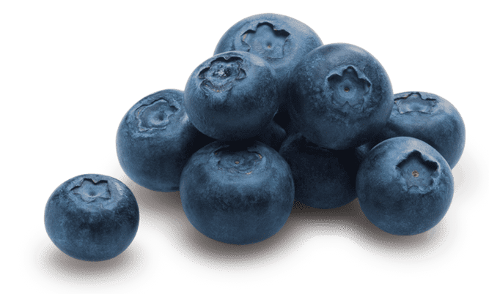
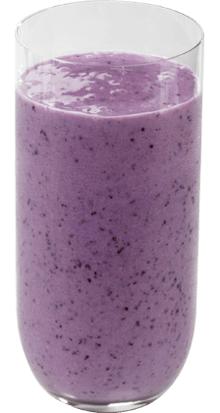
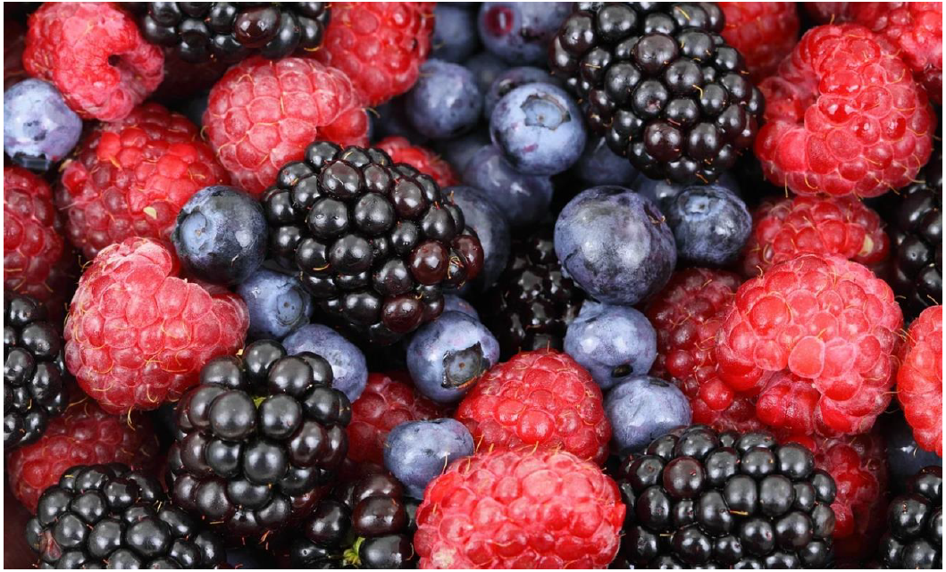
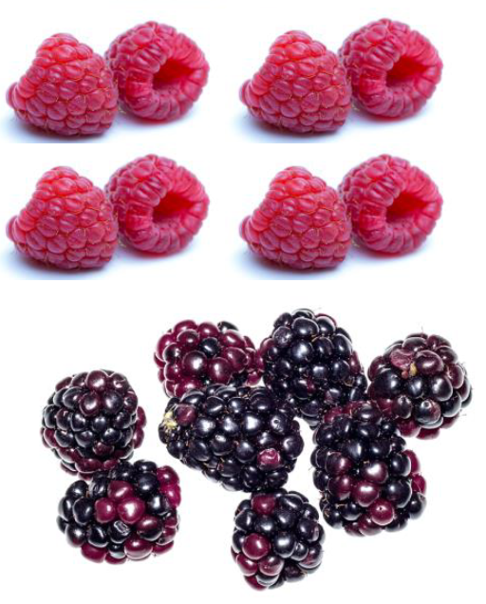
Increasing Resolution: single-cell analysis
Biological Sample
Bulk
RNA-Seq
Single-Cell
RNA-Seq

Slide 3

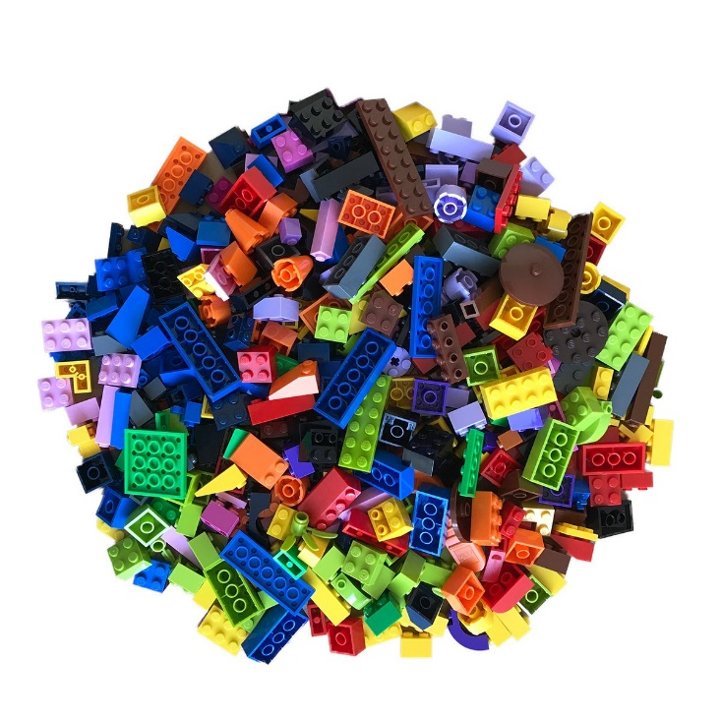
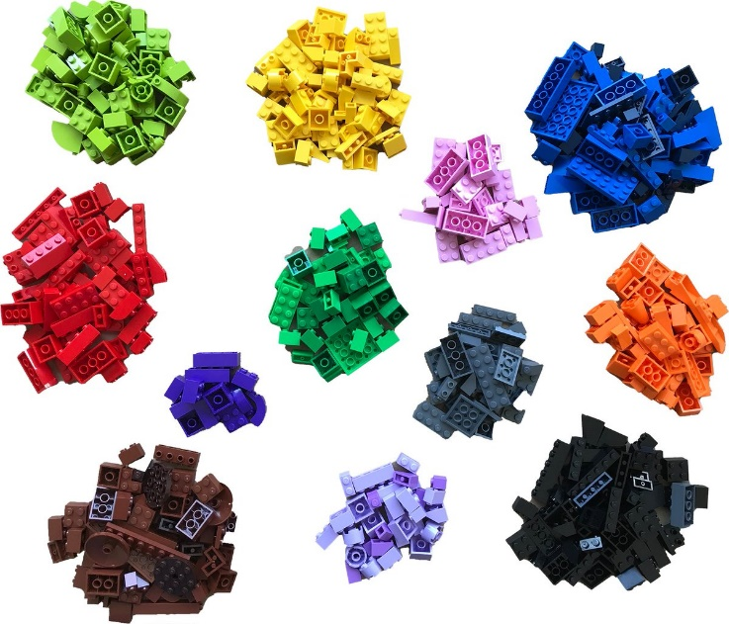

Increasing Resolution: single-cell analysis
Single-Cell
RNA-Seq
Bulk
RNA-Seq
Biological Sample
image idea from @boXia7

Slide 4
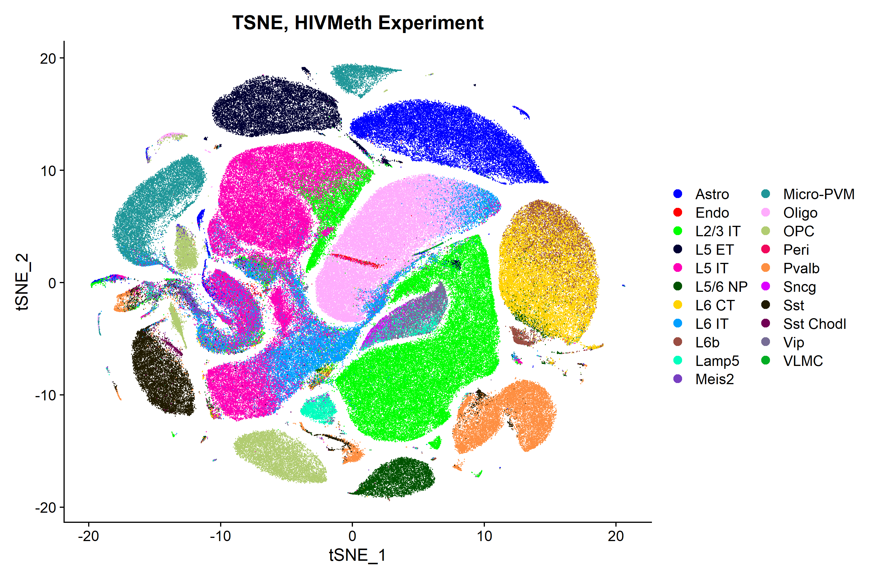
Increasing Resolution: single-cell analysis
L5 neurons ET
Astrocytes
L5 neurons IT
Microglia
Oligodendrocytes
L6 neurons CT
L6 neurons IT
Sst+ neurons
L2/3 neurons IT
Lamp5+ neurons
Pvalb+ neurons
Single-Cell
RNA-Seq
OPCs
L5/6 neurons NP

Slide 5
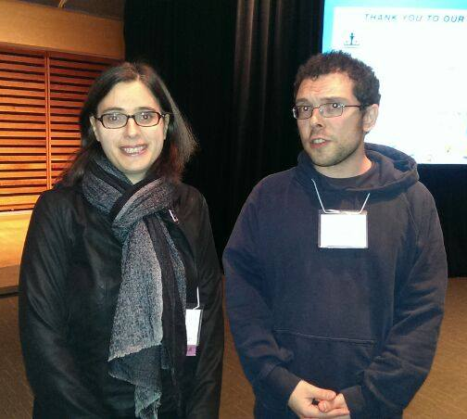
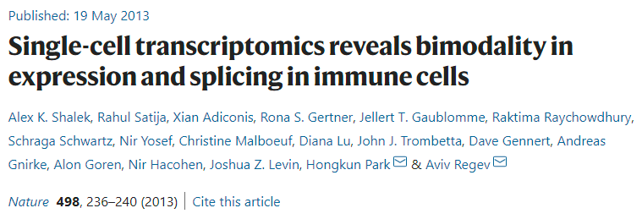
Single Cell: 10 years of challenges
Aviv Regev
Me
Toronto, 2013

Slide 6
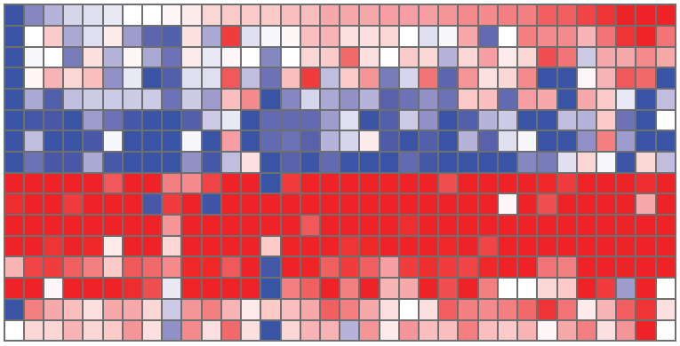
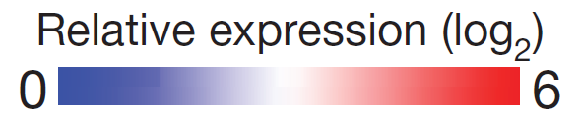
Gene expression at single cell level
34 Bone Marrow Derived cells
LPS-responding genes
Housekeeping genes
Shalek et al., 2013

Slide 7
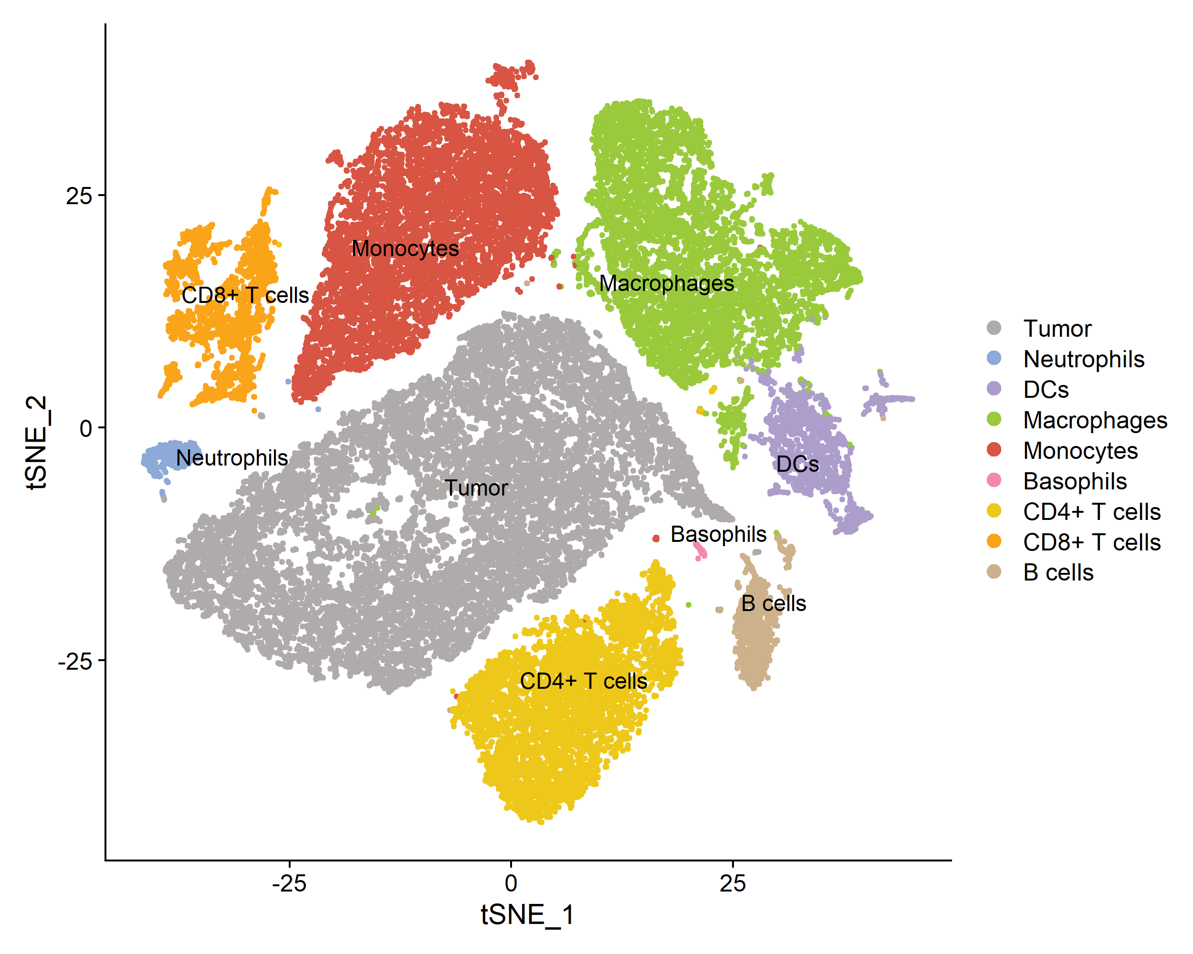
Single-Cell Transcriptomics Today
39,021 cells
Internal dataset, TH-MYCN mice
Manual cell annotation based on cluster-specific features
Thanks to Daniele Mercatelli and Orazio Vittorio (CCI Sydney)

Slide 8



The Sequencing Technology in 2022
More cells
Up to 50k cells per run
Still, incomplete Coverage
10k-100k reads/cell (bulk sequencing: 10M+)
Most prominent techs
Microcapillaries: Fluidigm
Droplets: 10x Genomics Chromium
Microwells: BD Rhapsody

Slide 9

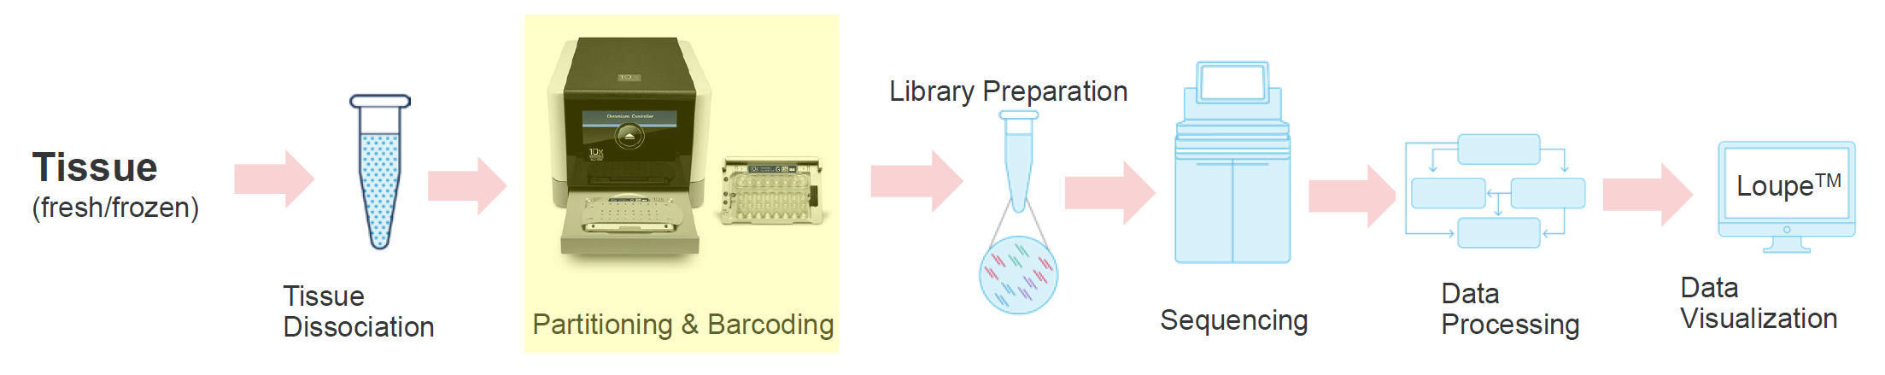
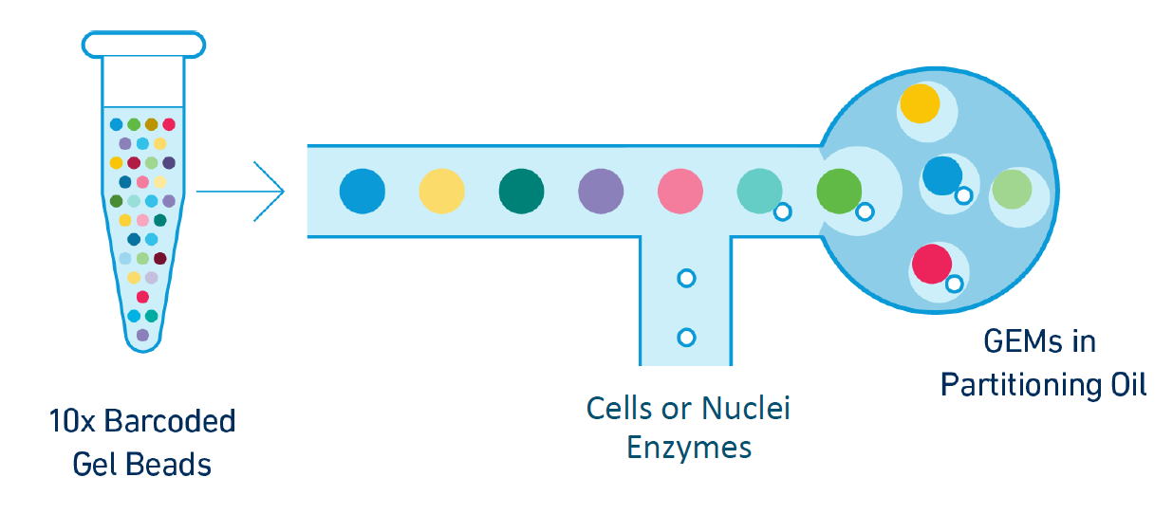
10x Genomics
Droplet-based: Gel beads in EMulsions (GEMs)

Slide 10
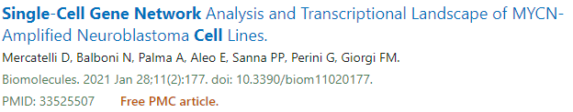
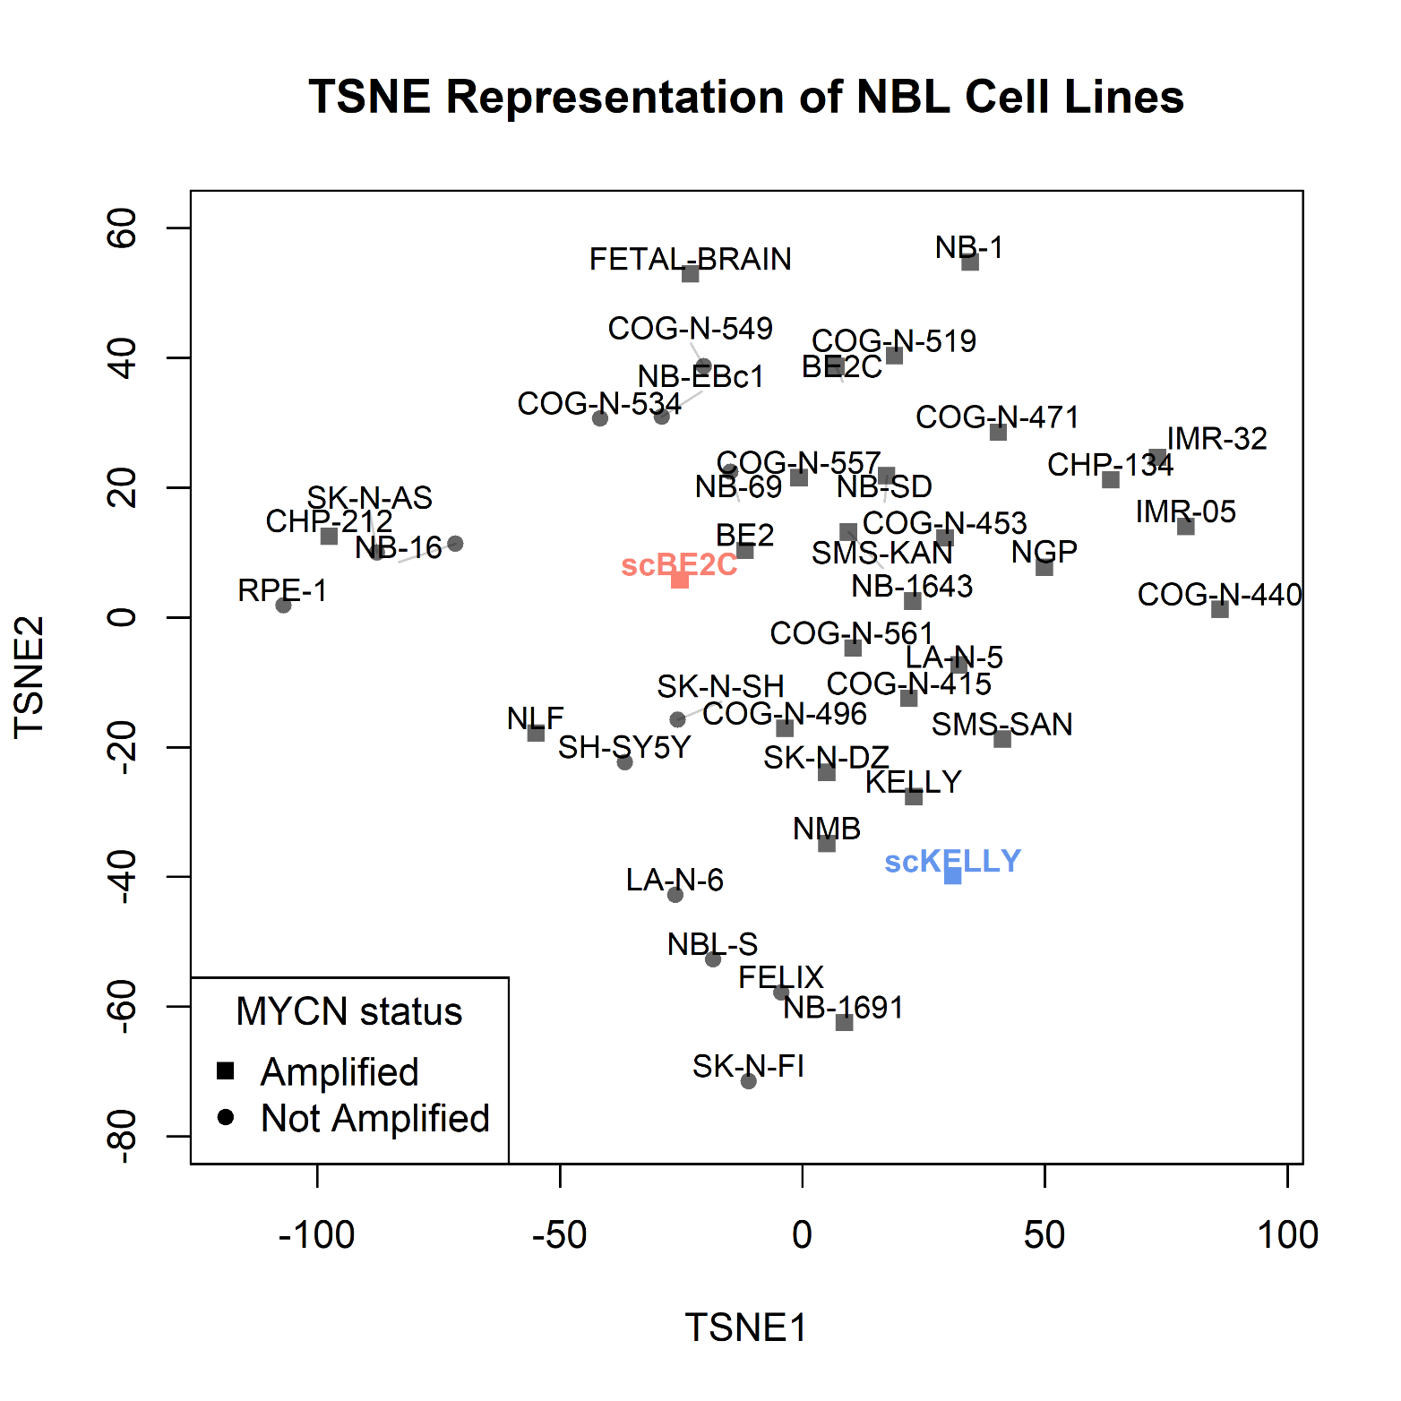
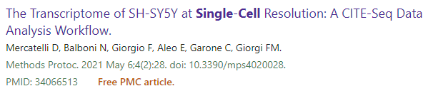
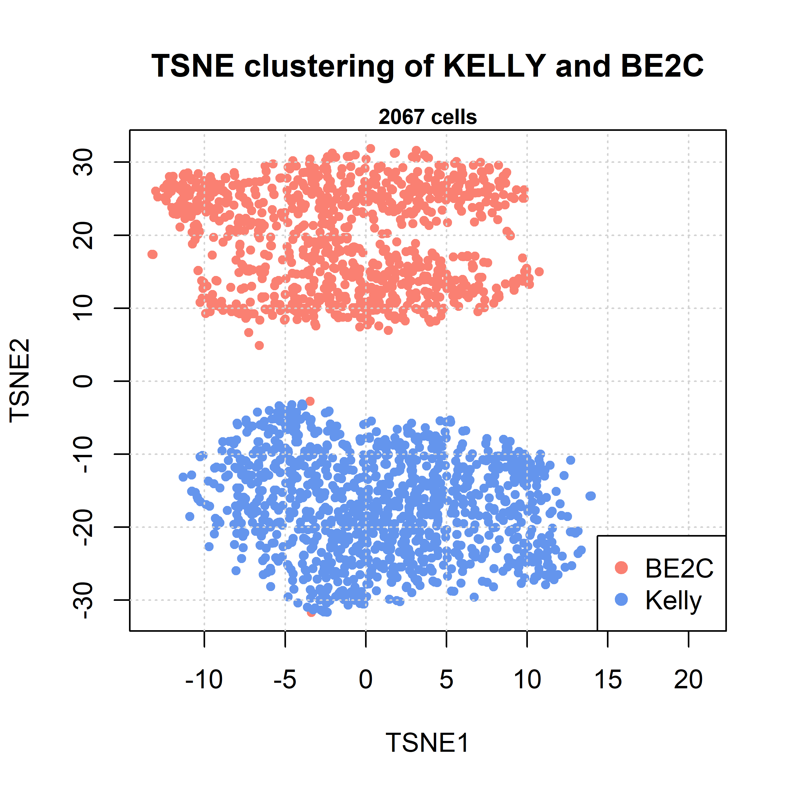
Recapitulating the information of bulk sequencing
Single-Cell Dataset
Comparison with bulk RNA-Seq data

Slide 11
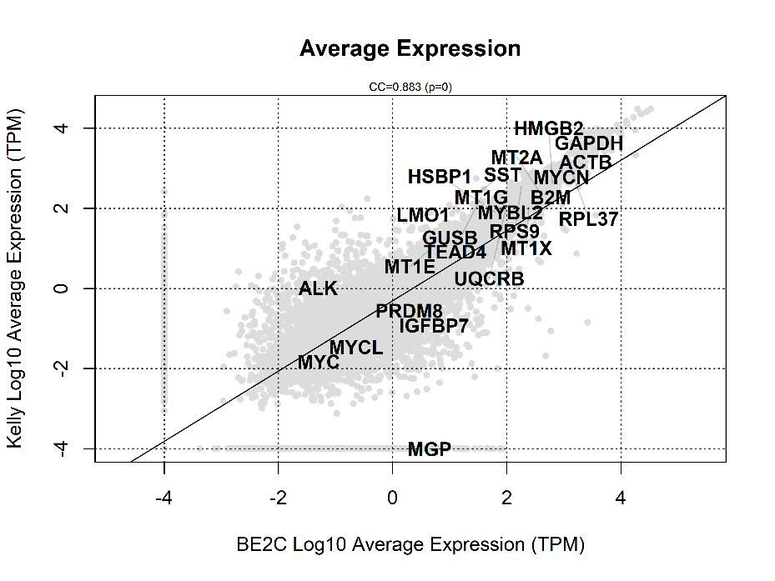
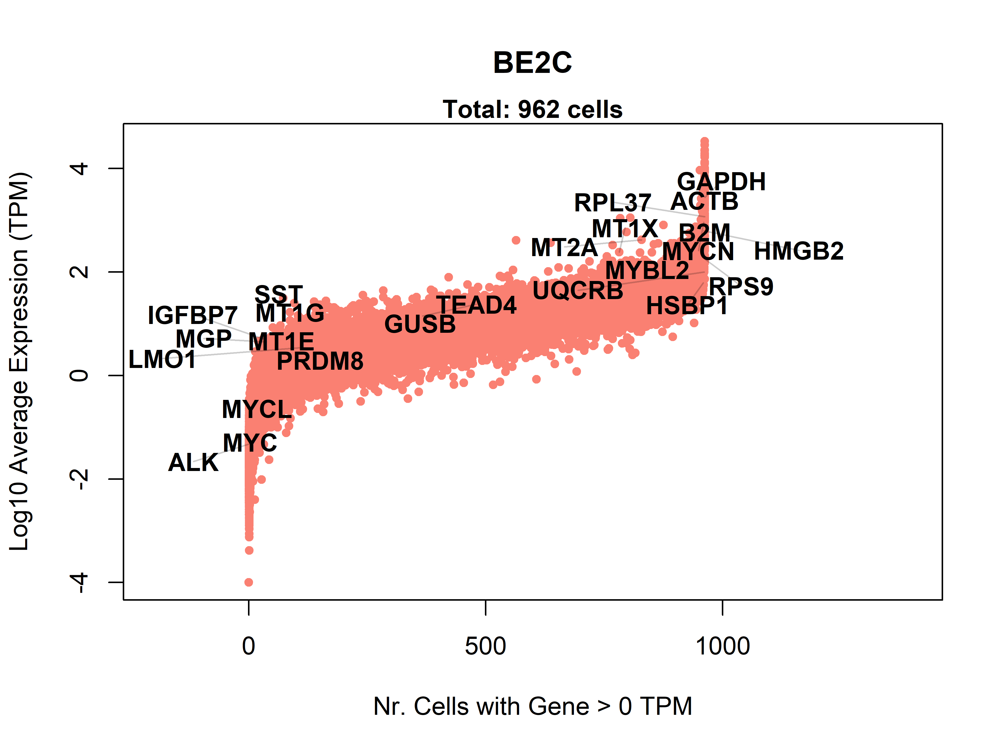
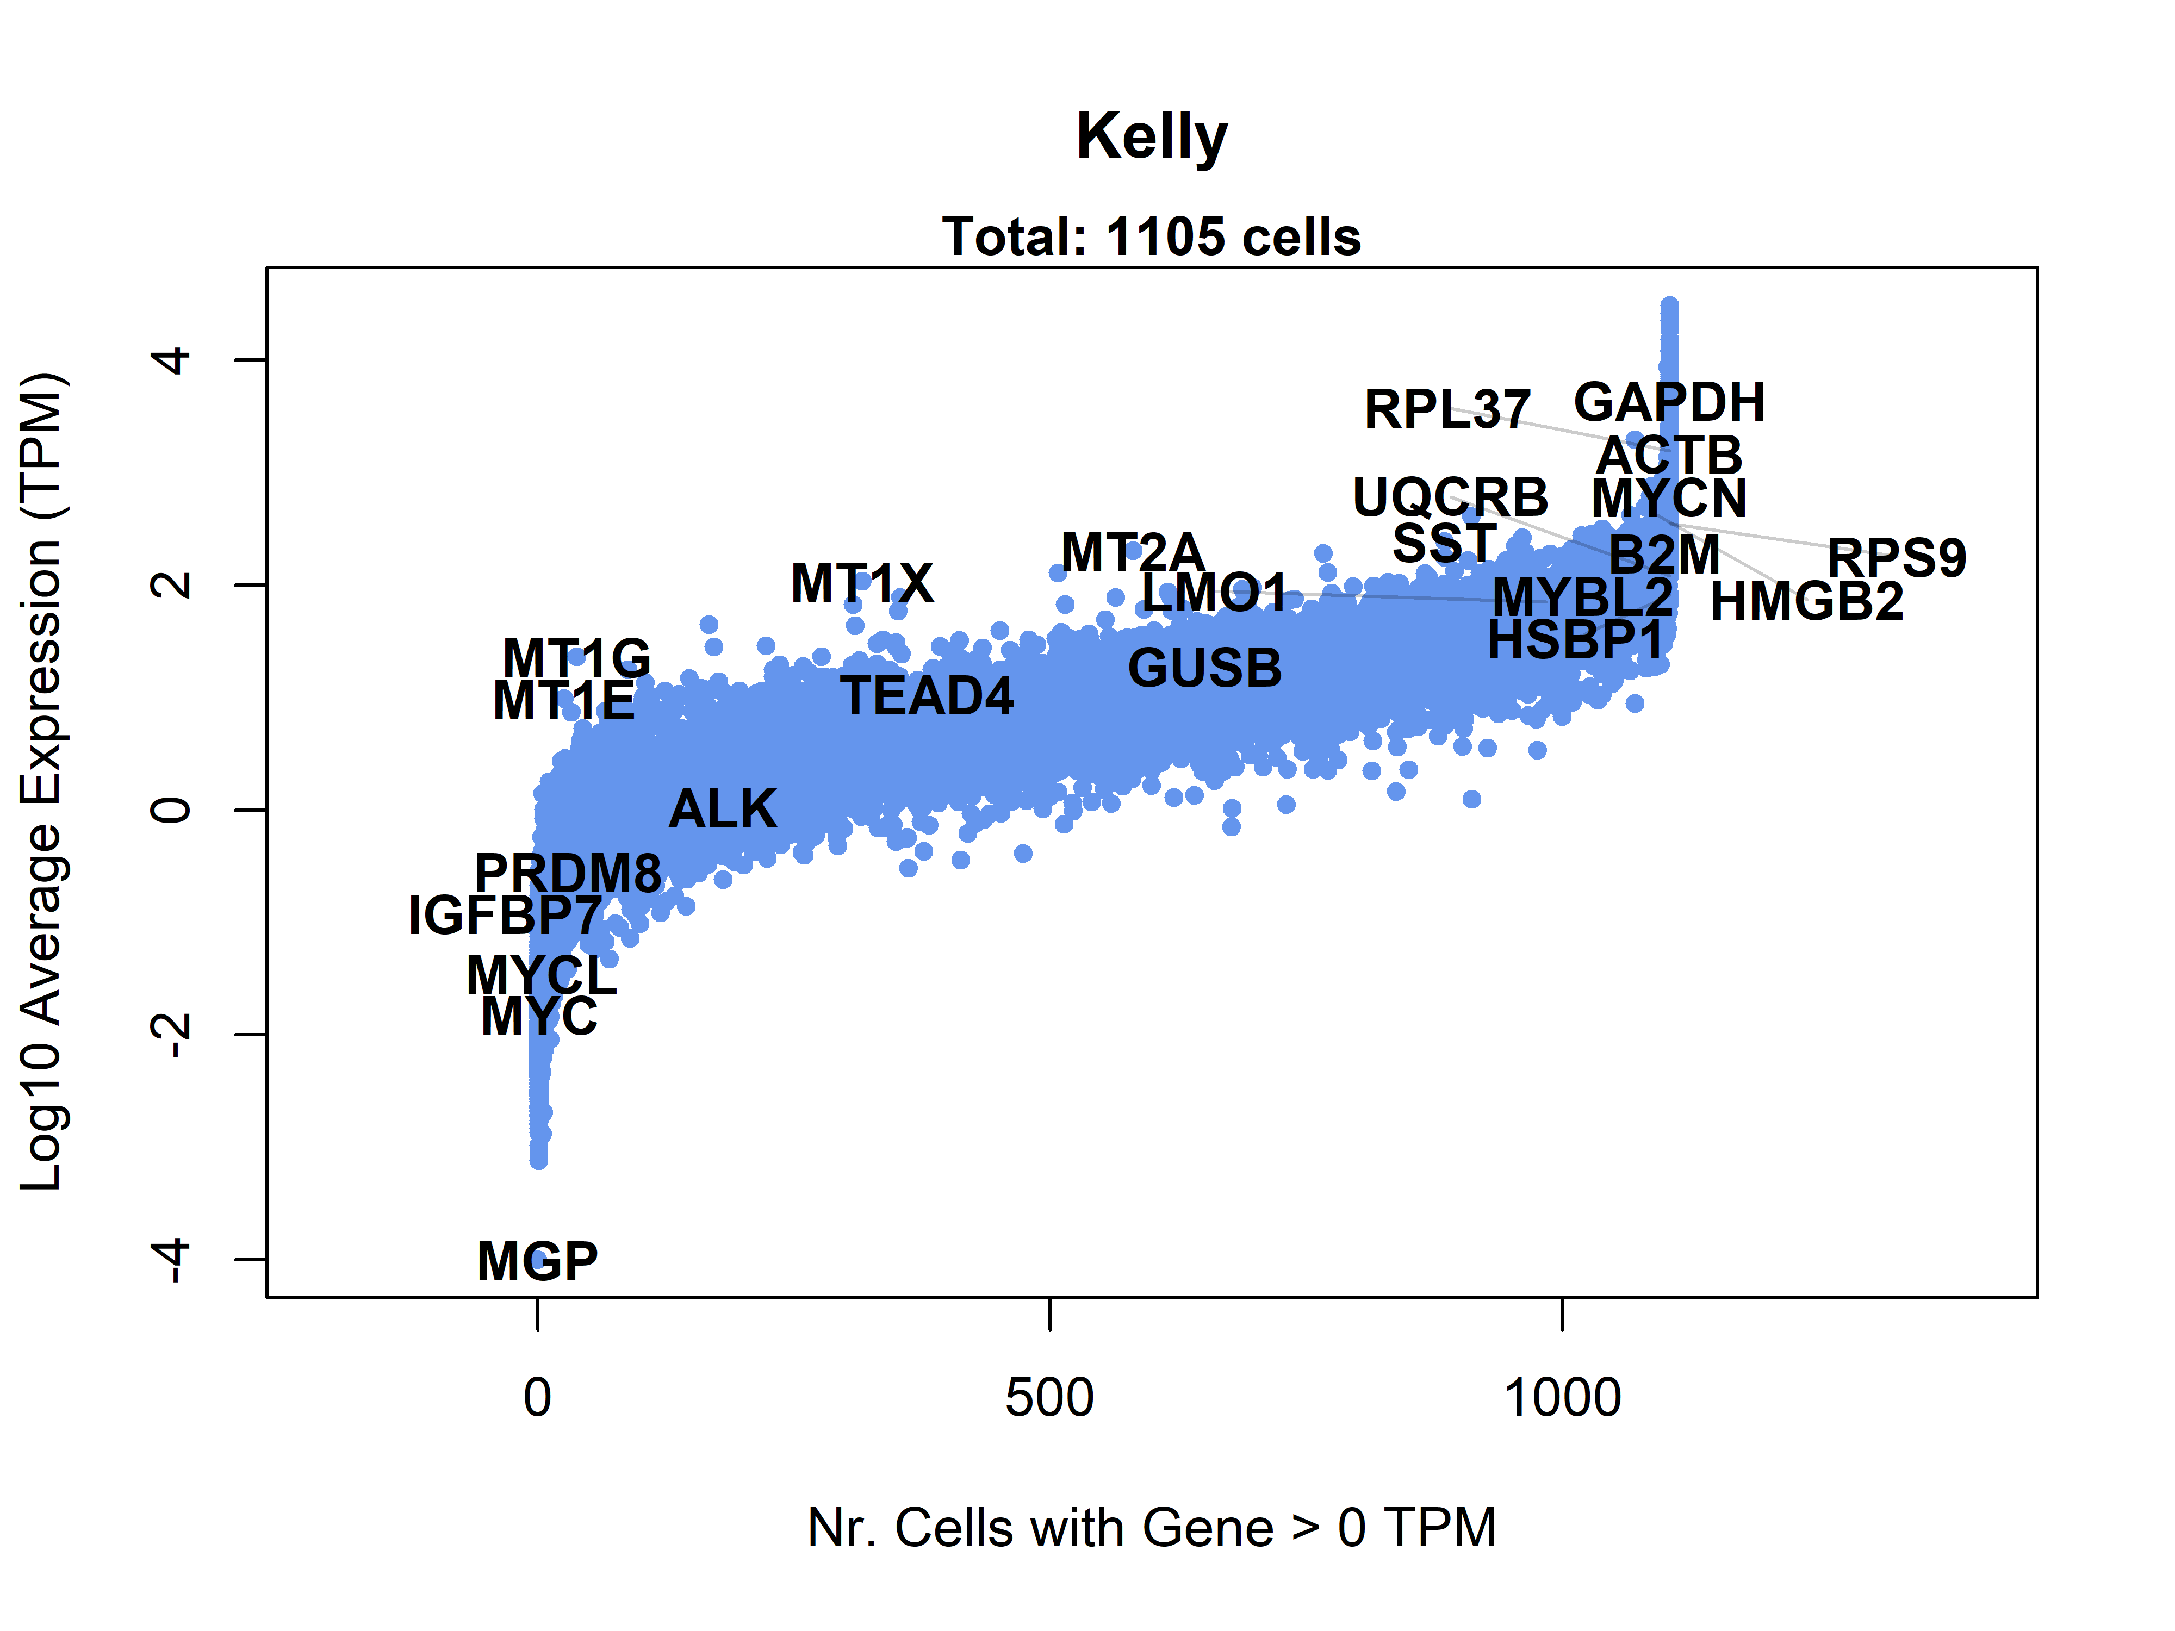
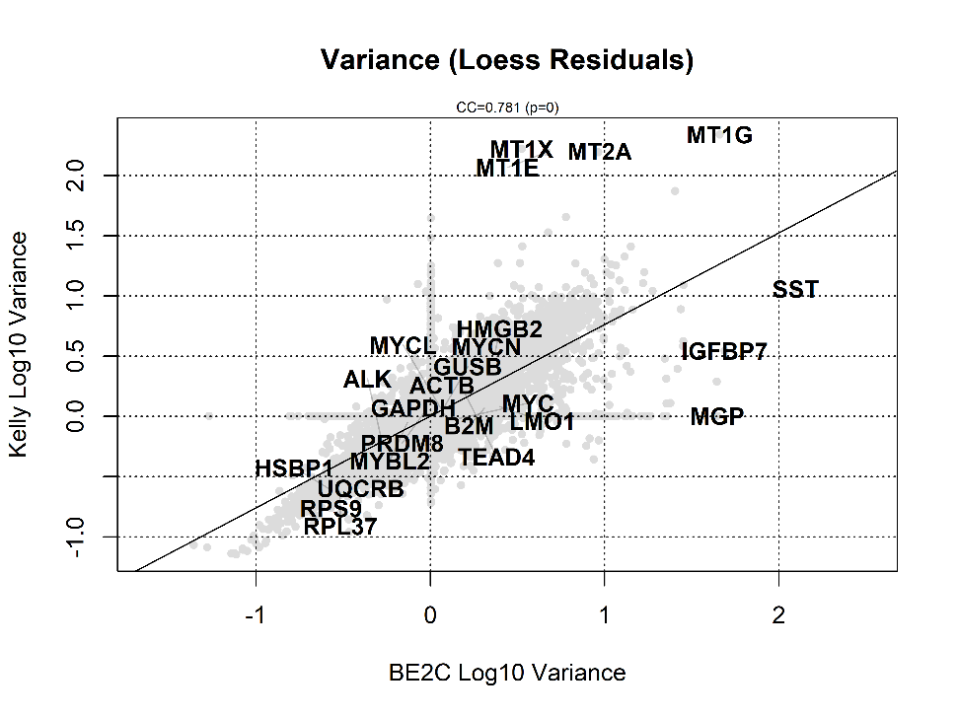
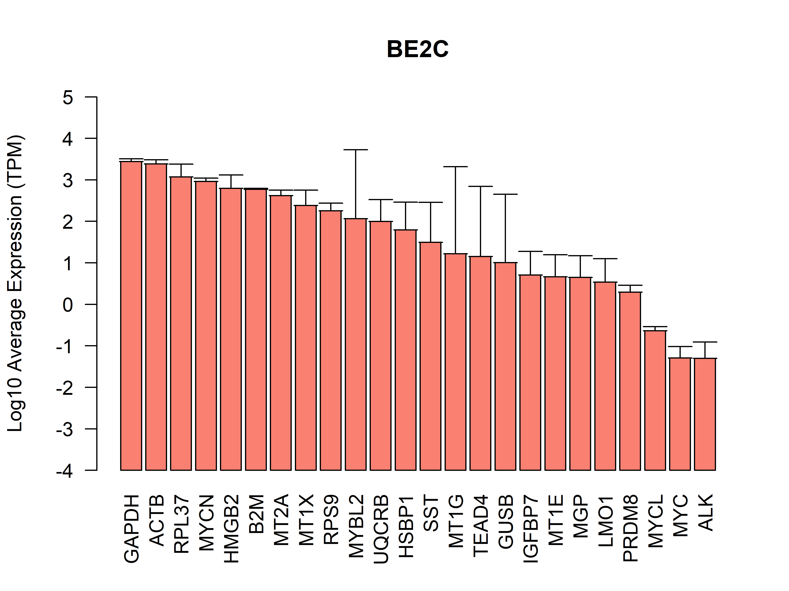
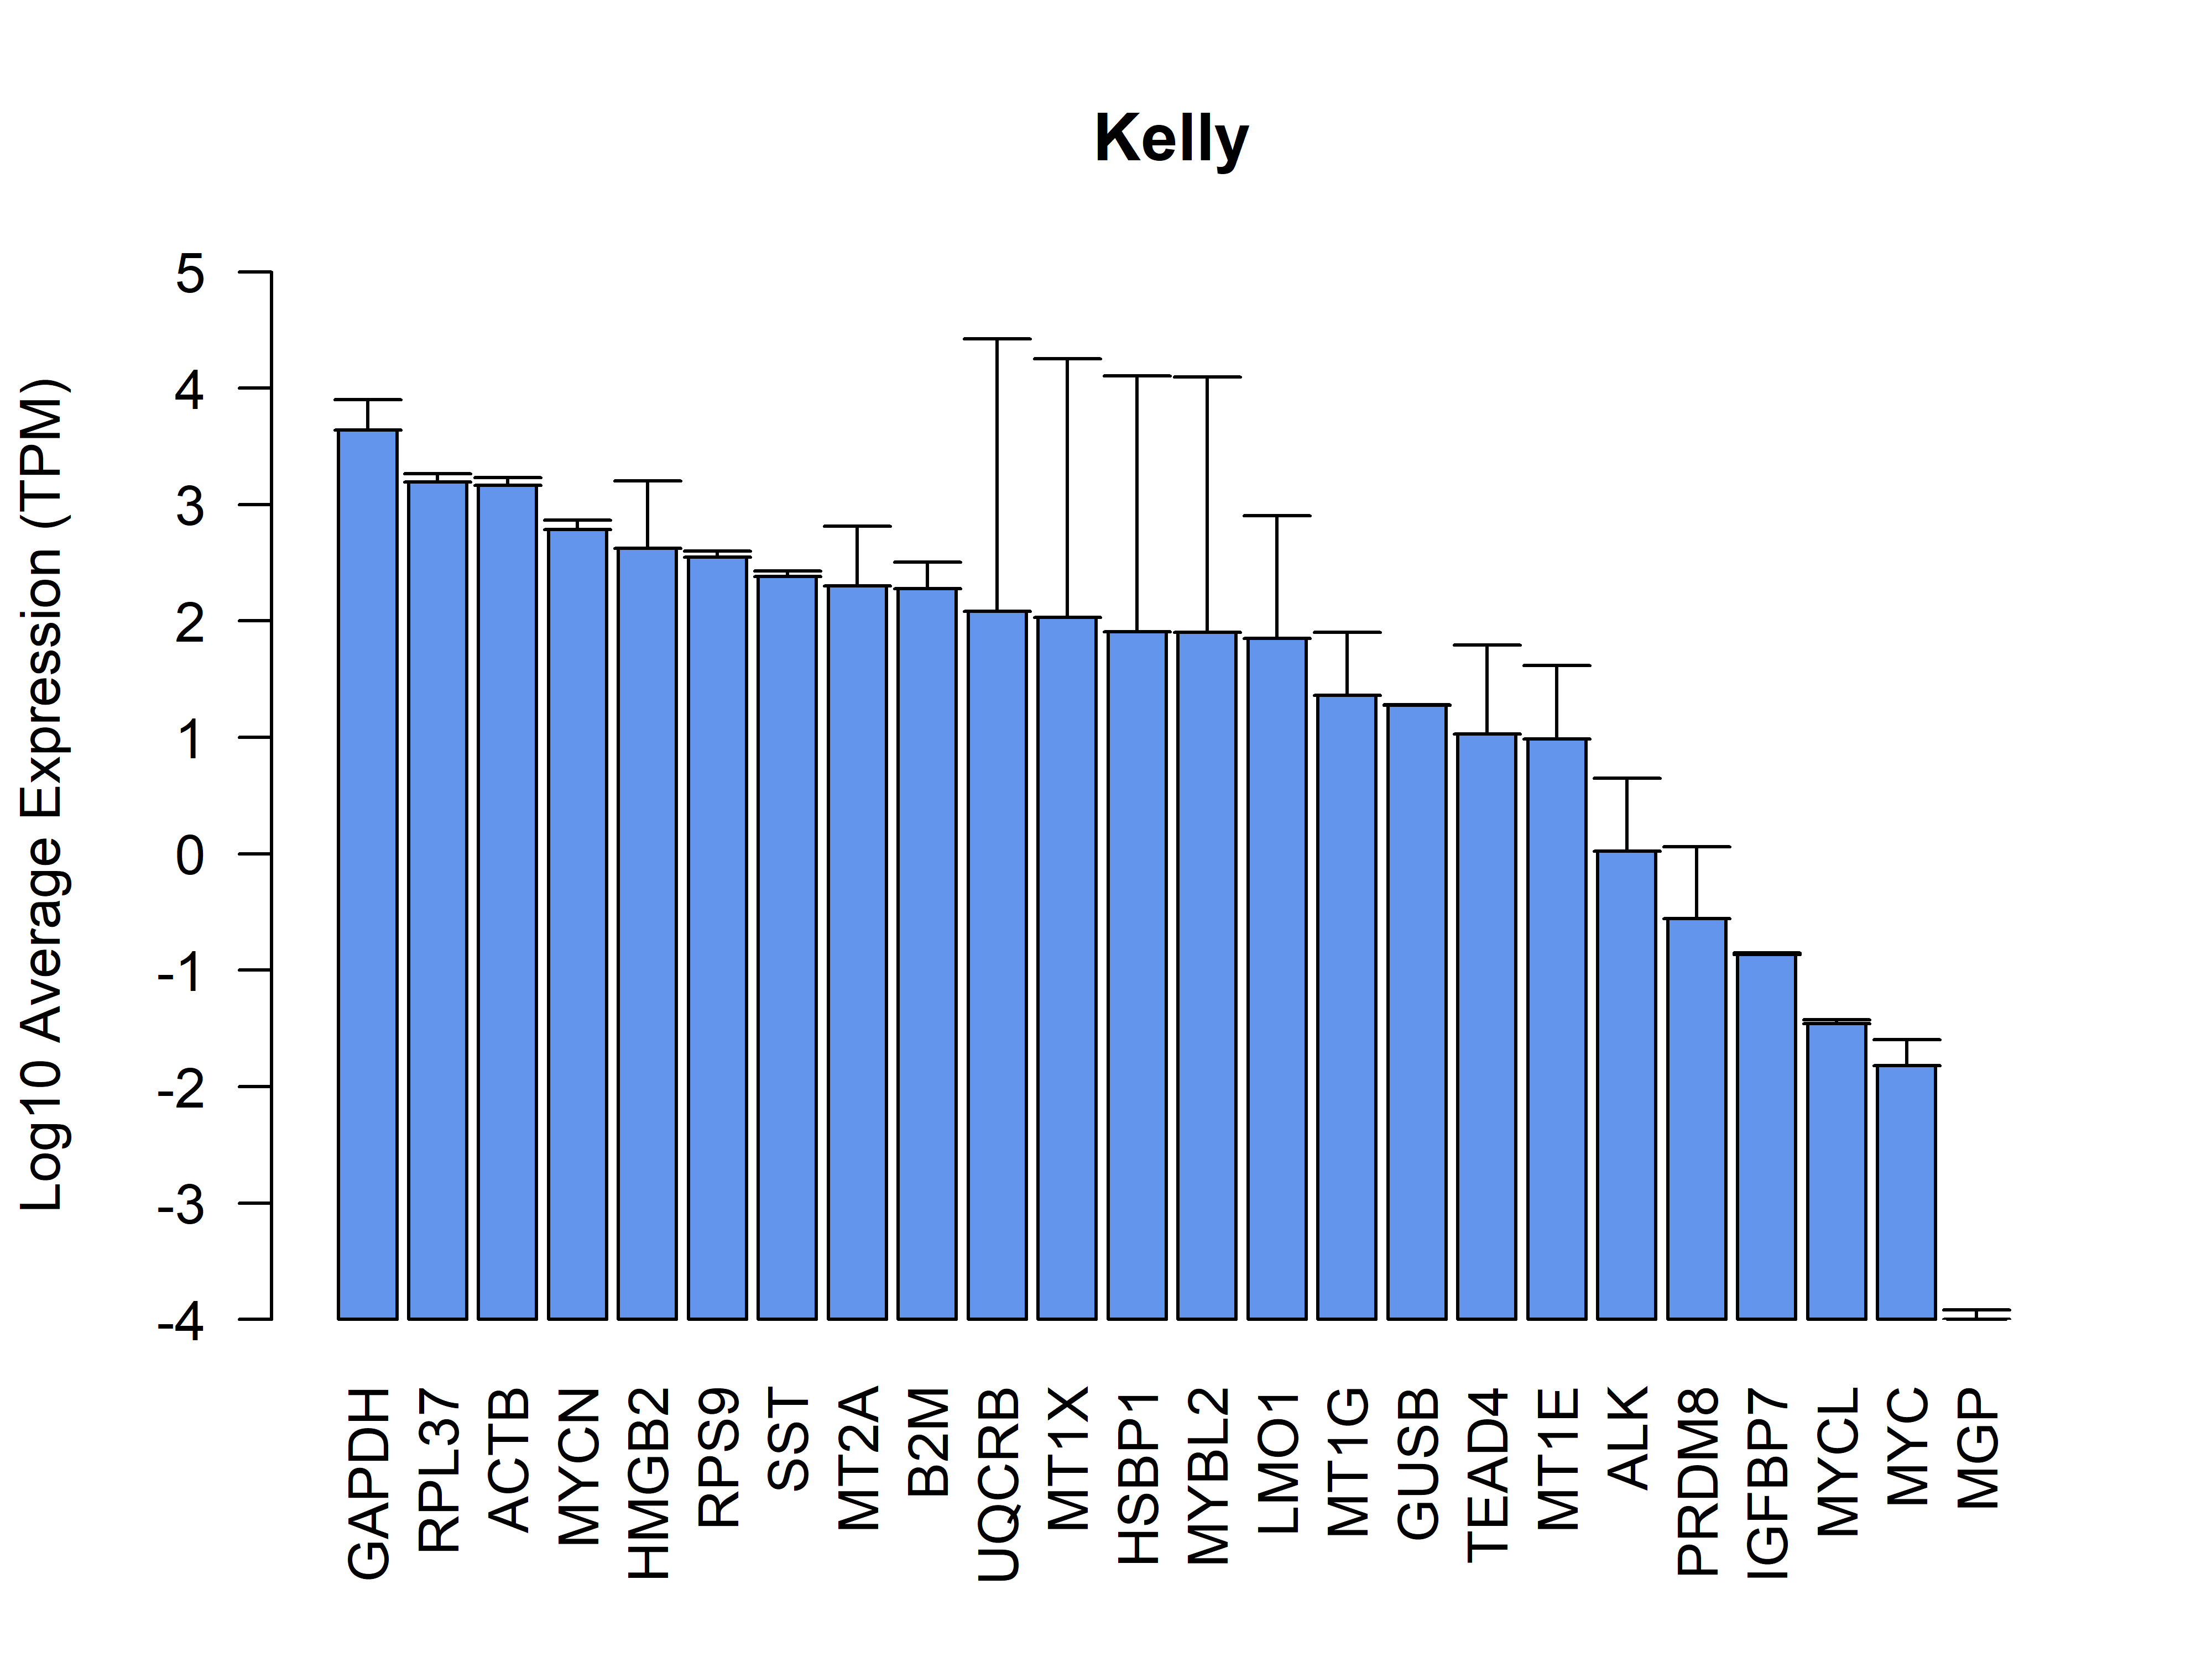
Defining good housekeeping genes via single cell data
High average expression
Expressed in all cells
Low variance within cell line
Low variance across cell lines

Slide 12
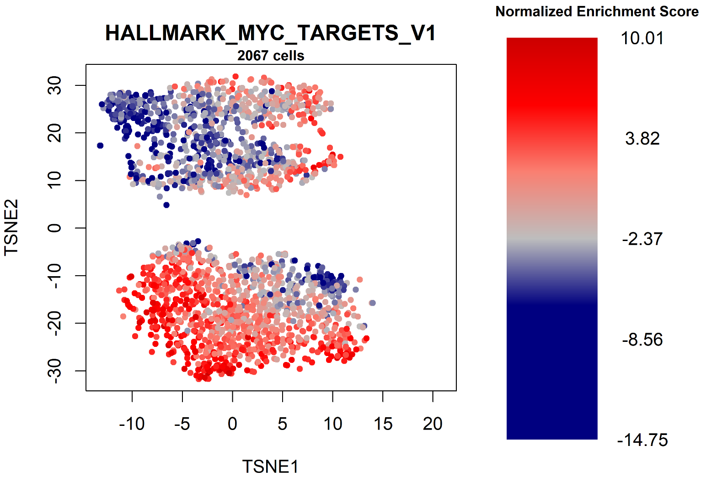
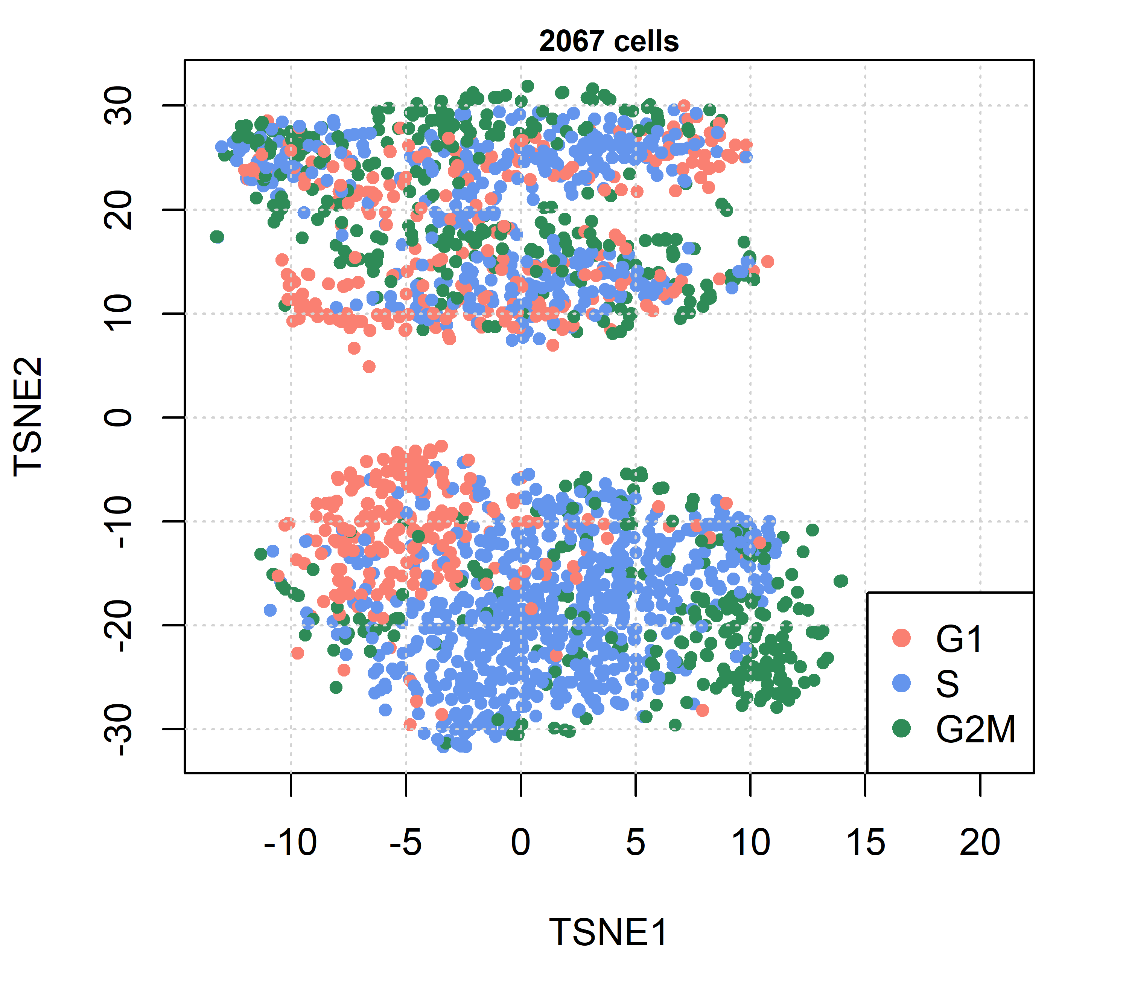
Overlaying pathway activity onto single cells
Cell Cycle
BE2C
Kelly
Activity algorithm (R packages: corto or viper)

Slide 13
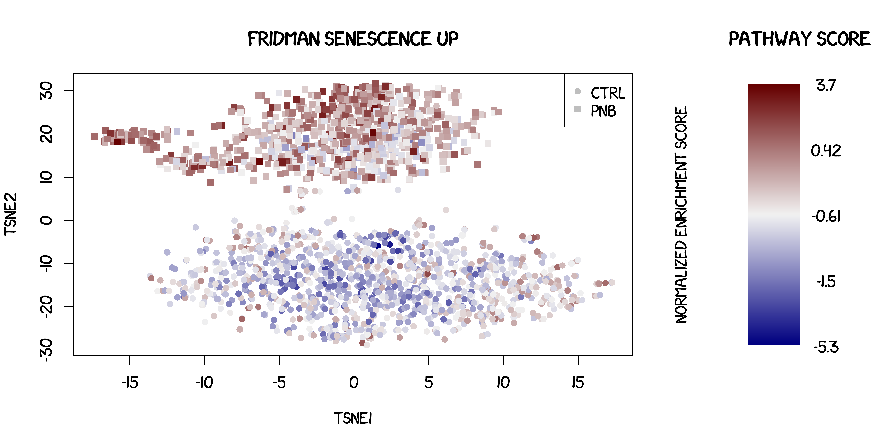
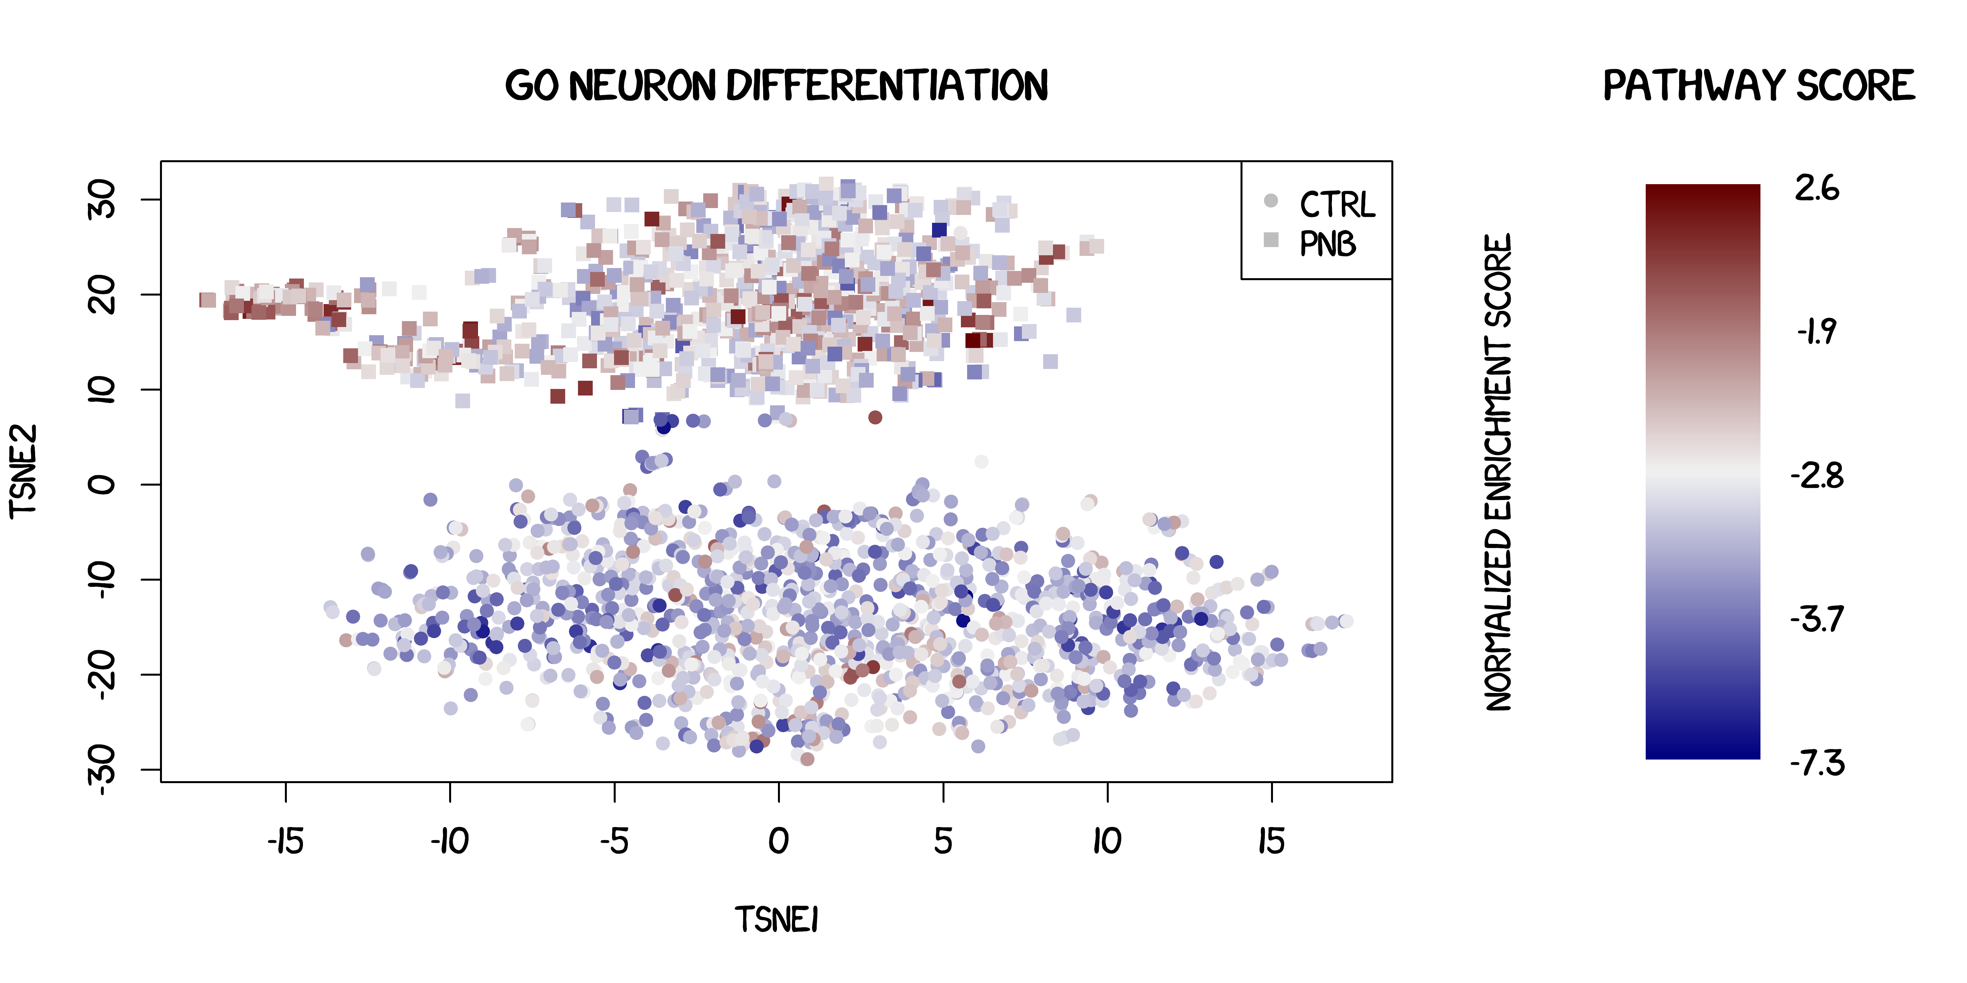
Panobinostat effects on BE2C cells
Pushing Senesce
Triggering neuronal differentiation

Slide 14
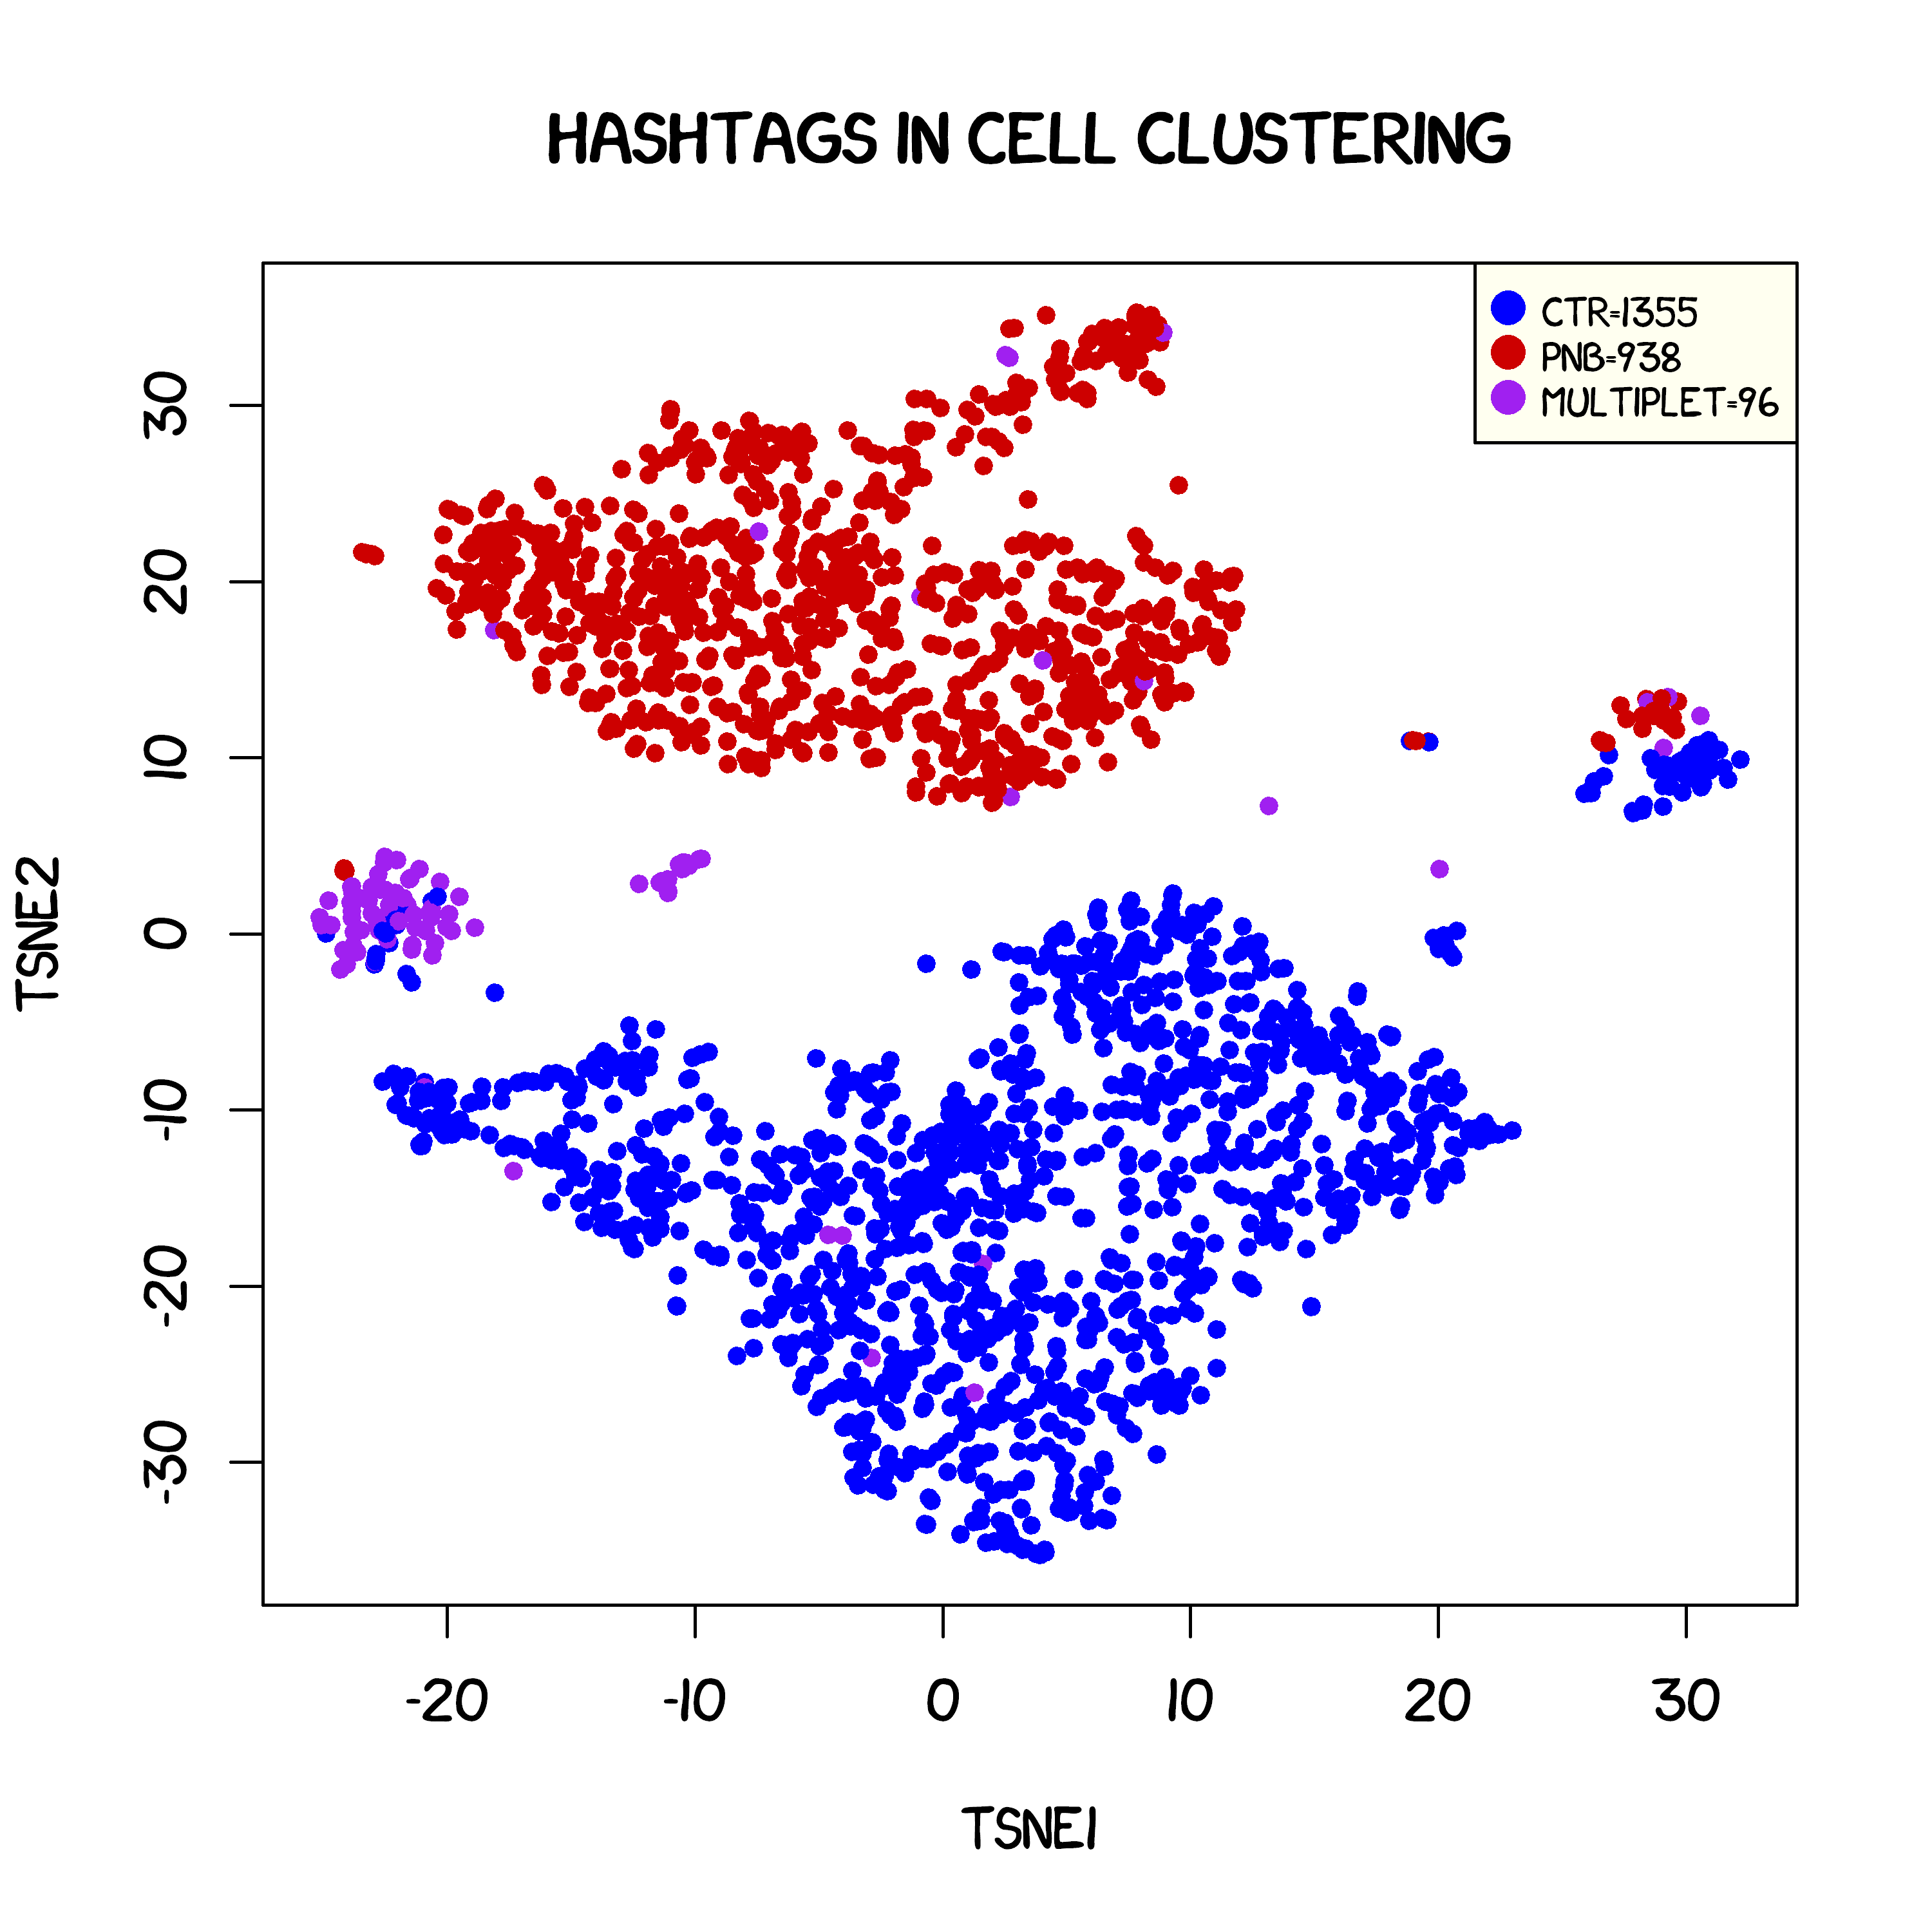
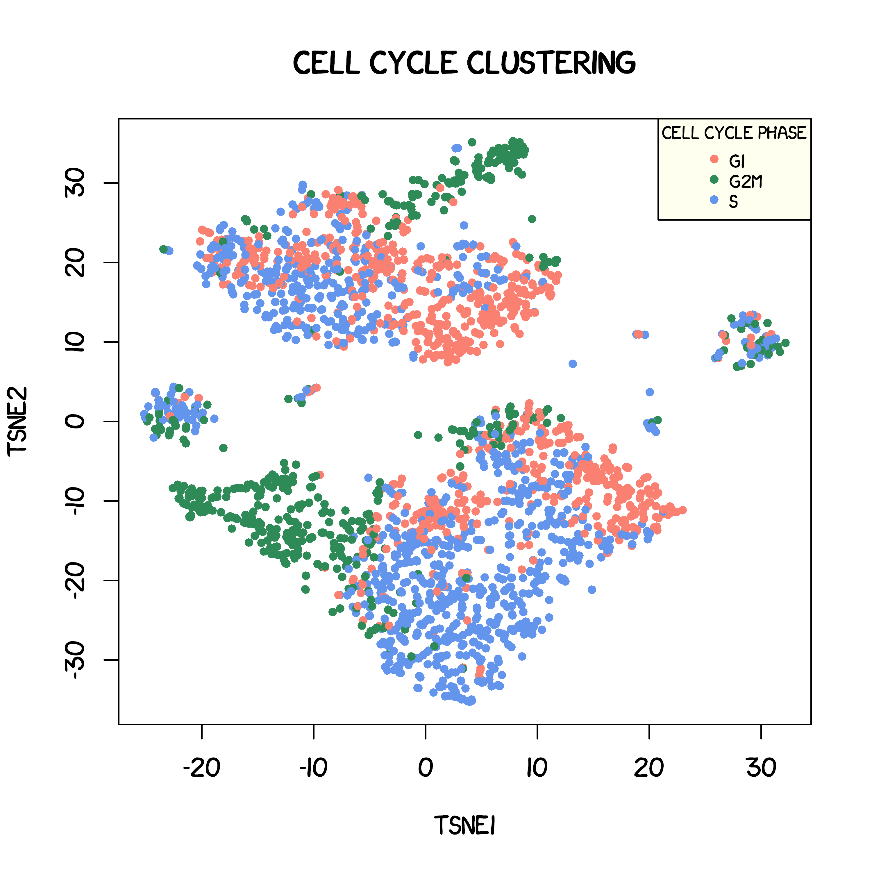
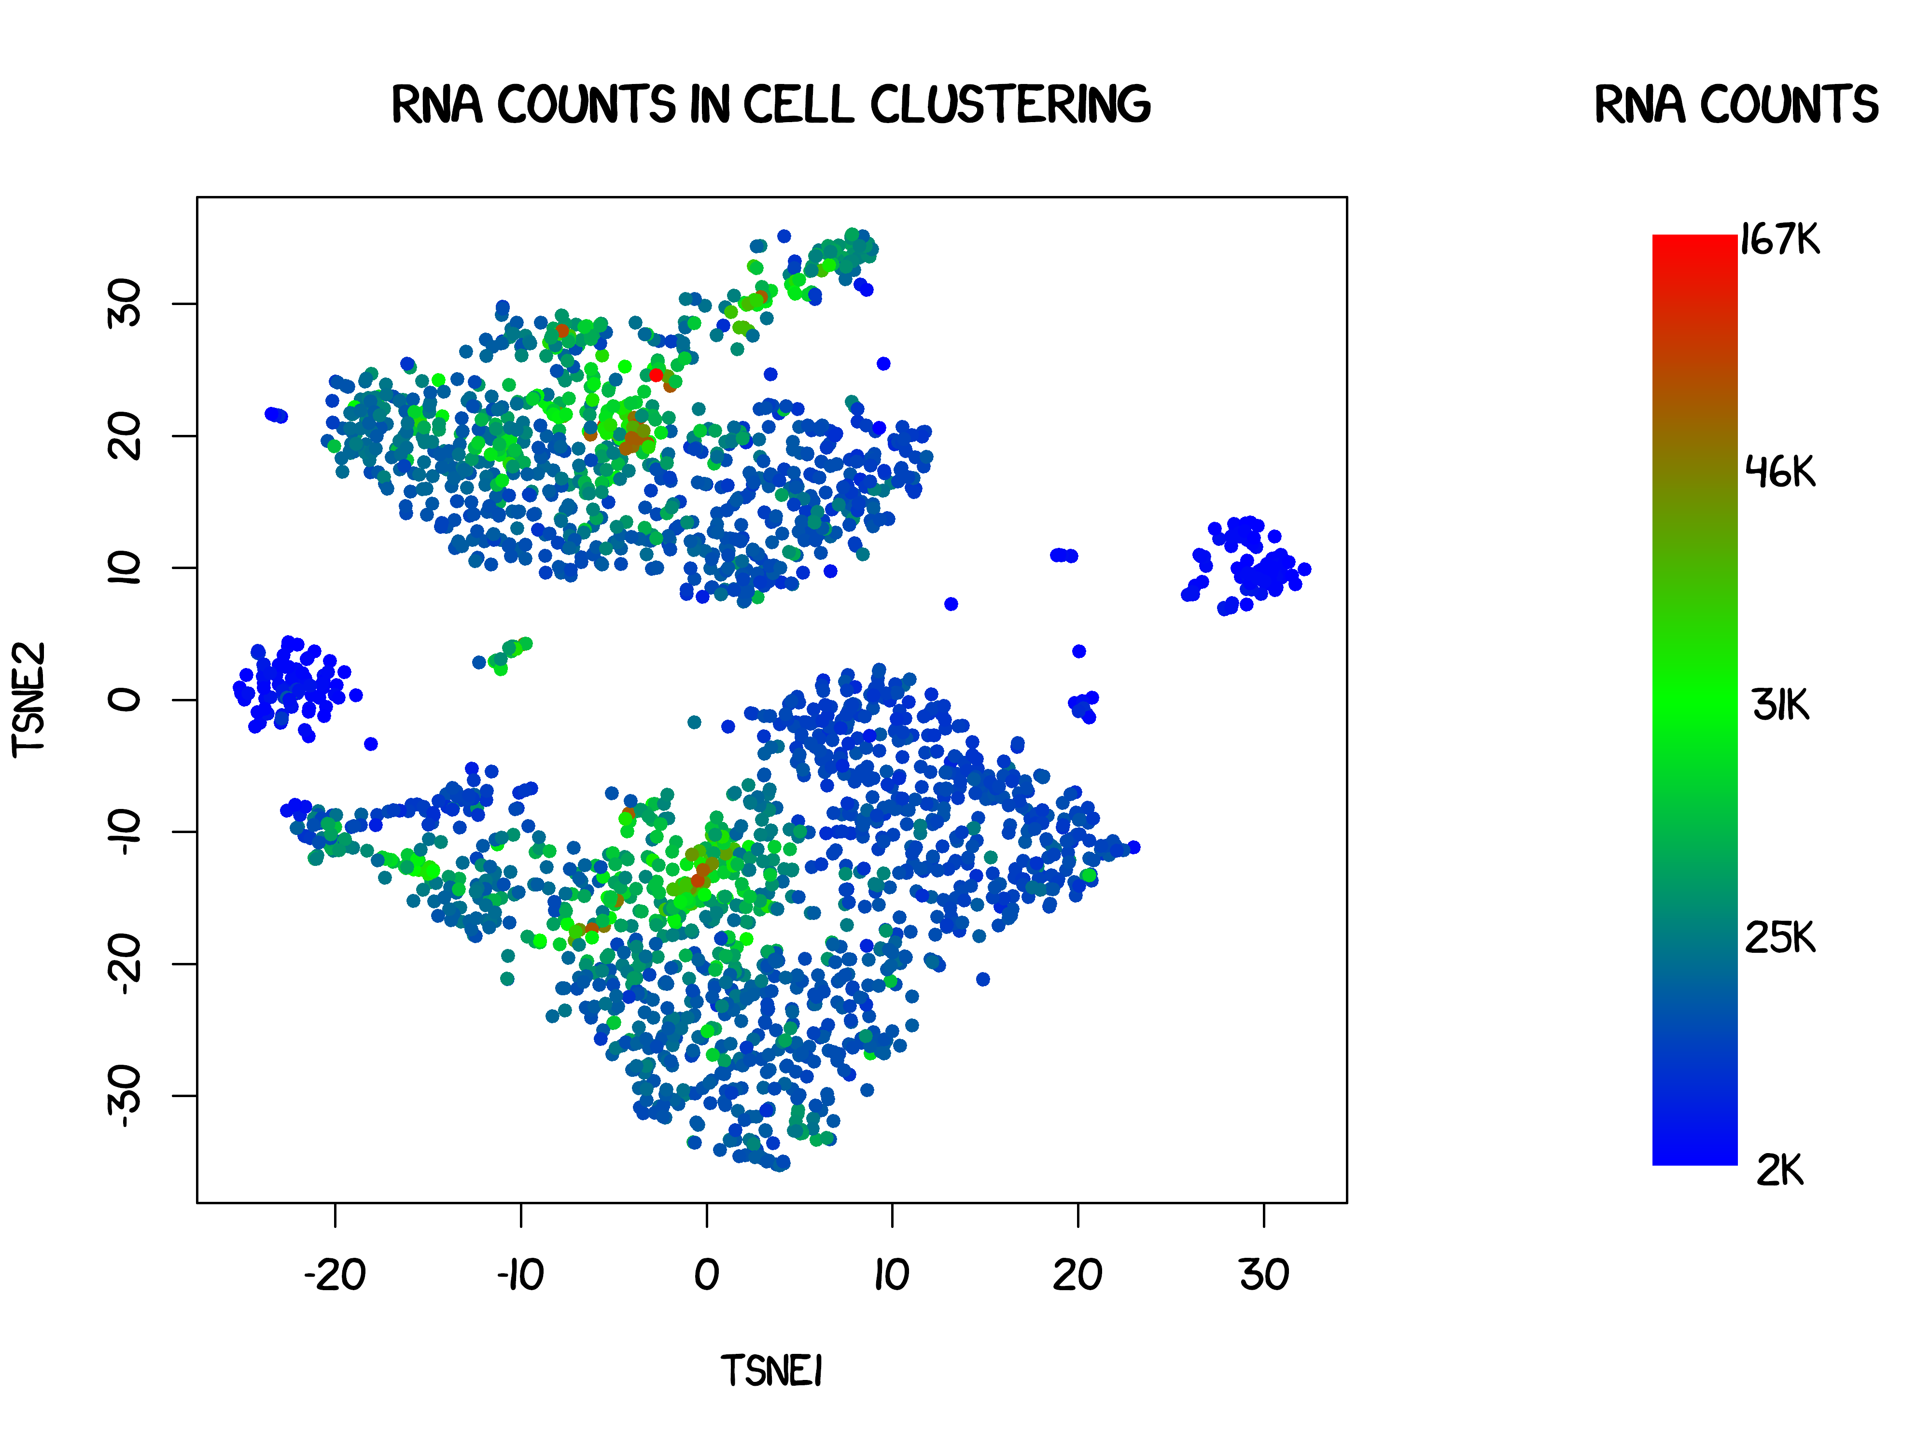
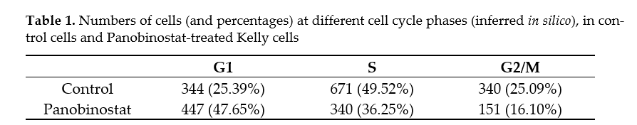
Main sources of variation
Treatment, cell cycle, number of transcripts
Median transcripts sequenced/cell: 30,000

Slide 15
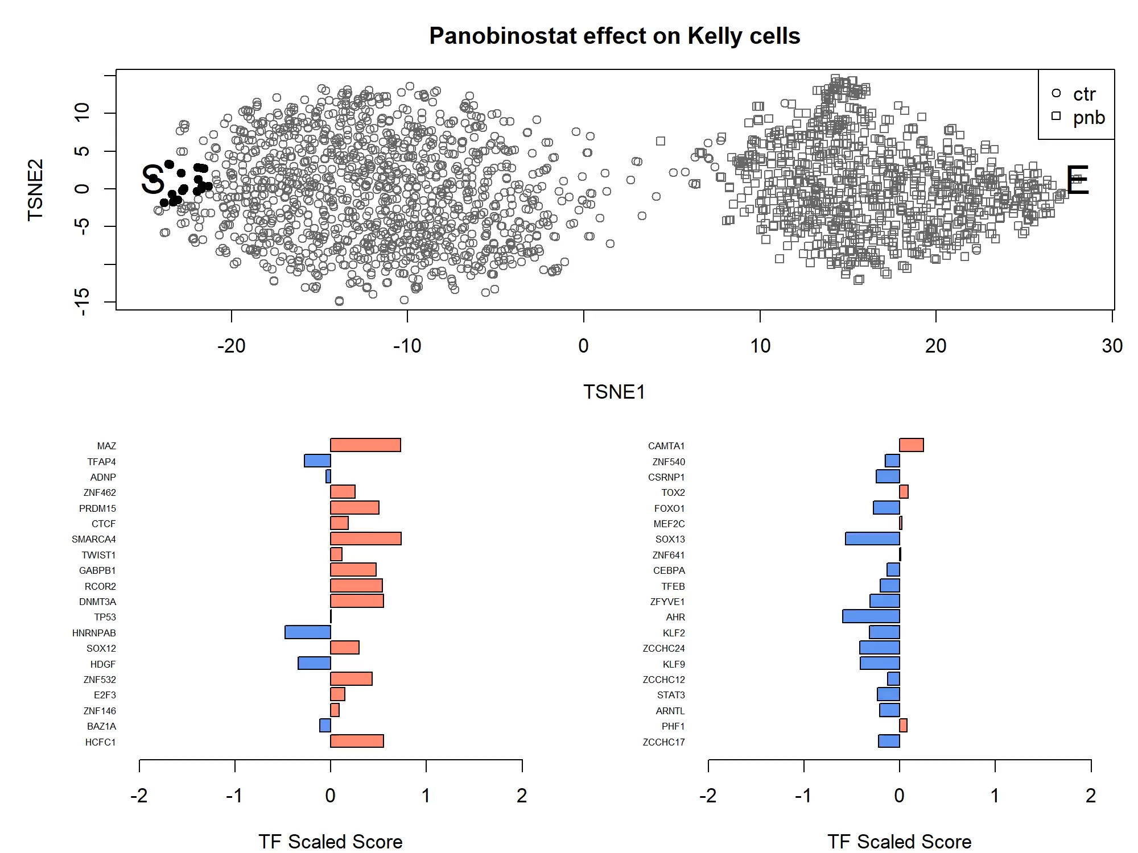
Transcriptome-wide Gradient effect of Panobinostat
Control
PNB treated

Slide 16
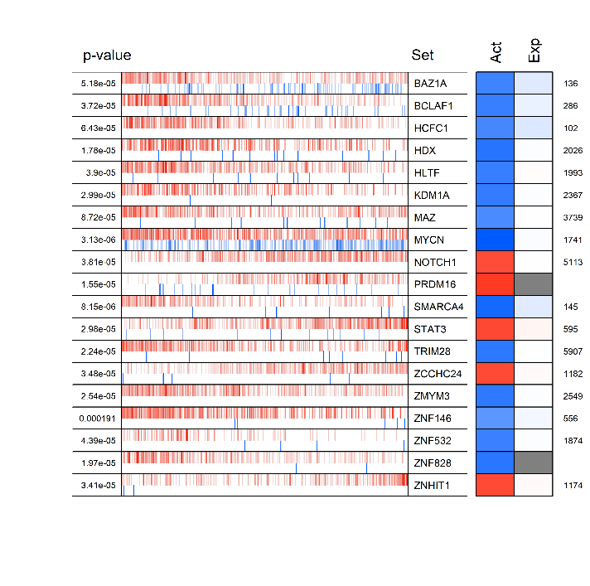
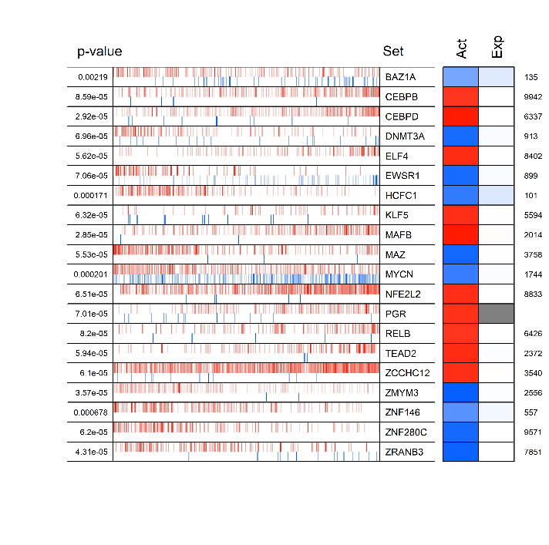
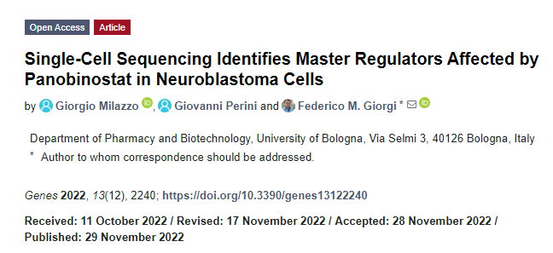
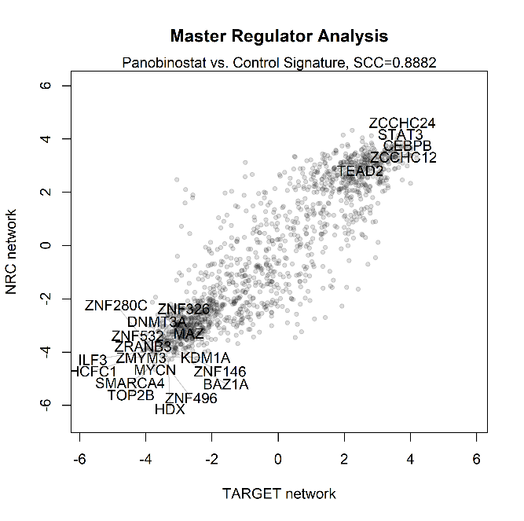
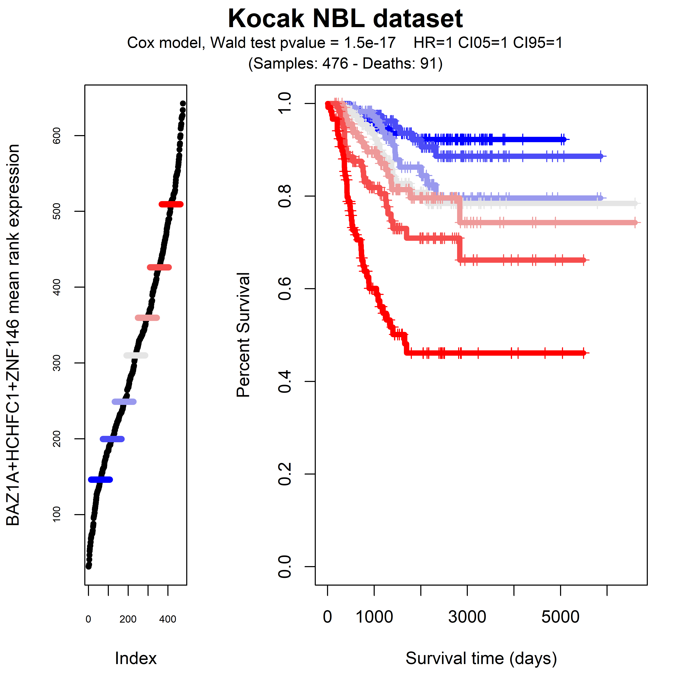
Master Regulators inhibited by Panobinostat are associated with poor prognosis
A
NRC network
B
TARGET network
C
D

Slide 17


Single-Cell Transcriptomics of Rat Brains
Context
Tissues: medial prefrontal cortex (PFC), striatum, and basolateral amygdala (BLA)
Perturbation 1: HIV rats and WT rats
Perturbation 2: Intravenous METH self-administration
Combination of both perturbations
Tissue will be snap-frozen tissue to decouple tissue acquisition from sample processing
Deliverables
Cell-type specific differential gene expression
Pathway Enrichment Analysis
Master Regulator Analysis (a.k.a. gene network enrichment analysis)
Prediction of mitigating drugs

Slide 18
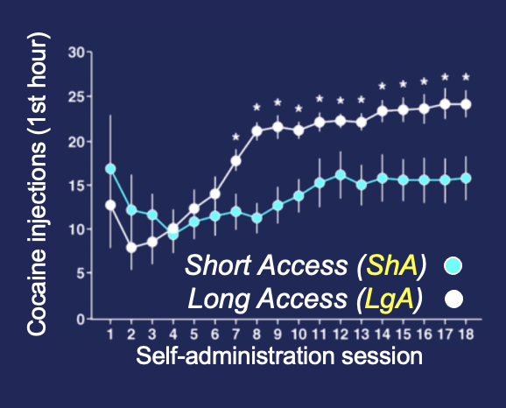
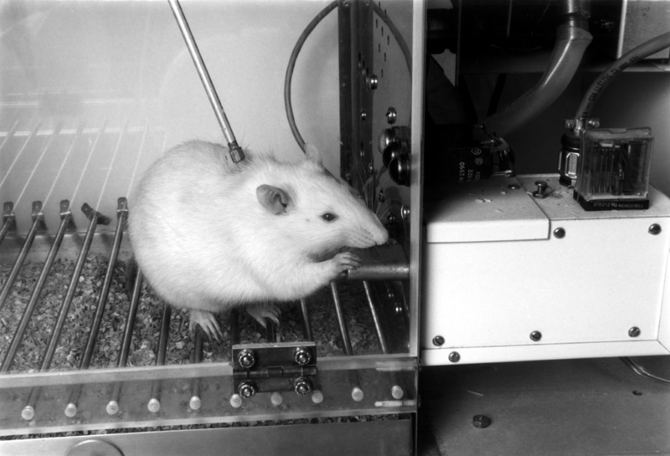
Intravenous escalated self-administration
HIV-1 Tg rats as a model of neuroHIV and METH drug abuse
Short Access (ShA): 1 hour daily access stable intake
(Ahmed et al. PNAS 2005)
Slide courtesy of Pietro Sanna (Scripps Research)

Slide 19
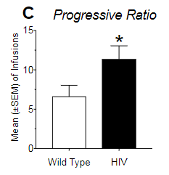
Experimental design
Escalated METH:
Under progressive ratio condition
(Sensitive measure of motivation, obtained by increasing the number of levers pressed to obtain the reward)
Thanks to Vez Canonigo (Sanna Lab)

Slide 20
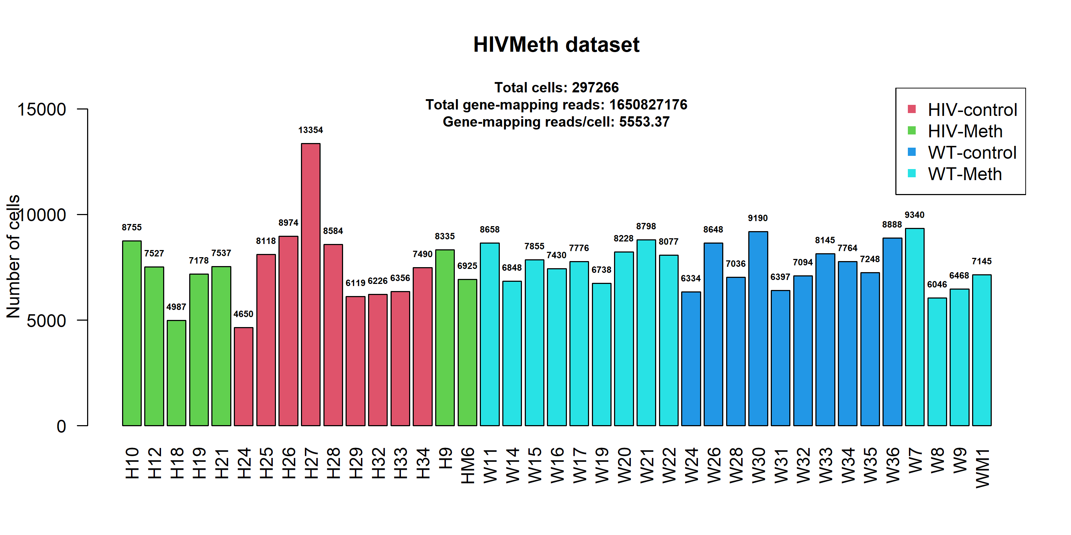
Nuclei per sample
WT-control: 10 samples
HIV-control: 9 samples
WT-meth: 13 samples
HIV-meth: 7 samples
Nuclei/sample = 297266/39 = 7622.2

Slide 21
2D TSNE projection of cell types
QC, min.cells=3, min.genes=200

Slide 22
Annotation: associating cells to cell type
L5 neurons ET
Astrocytes
L5 neurons IT
Microglia
Oligodendrocytes
L6 neurons CT
L6 neurons IT
Sst+ neurons
L2/3 neurons IT
Lamp5+ neurons
Pvalb+ neurons
OPCs
L5/6 neurons NP
QC, min.cells=3, min.genes=200

Slide 23
Reference-based Azimuth Cell types assignment
Label | Expanded Label | OBO Ontology ID | Markers
Astro | Astrocyte | astrocyte | Gpc5, Slc1a2, Slc1a3, Apoe, Wdr17, Plpp3, Rorb, Rmst, Slc4a4, Htra1
Endo | Endothelial cell | endothelial cell | Flt1, Slco1a4, Adgrl4, Ly6c1, Slc2a1, Klf2, Mecom, Bsg, Ly6a, Pltp
L2/3 IT | Layer 2-3 glutamatergic neuron, intratelencephalon-projecting | glutamatergic neuron | Lingo2, Dscaml1, Gpc6, Fam19a1, Lrrtm4, Slit3, Cux2, Unc5d, Fstl4, Car10
L5 ET | Layer 5 glutamatergic neuron, extratelencephalon-projecting | glutamatergic neuron | Fam19a1, Tox, Sgcz, Robo1, Galntl6, Gm2164, Dscaml1, Gm28928, Pex5l, Ralyl
L5 IT | Layer 5 glutamatergic neuron, intratelencephalon-projecting | glutamatergic neuron | Car10, Ncam2, Galntl6, Cdh12, Hs3st4, Gpc6, Unc5d, Tenm4, Ptprd, Hs6st3
L5/6 NP | Layer 5-6 glutamatergic neuron, near-projecting | glutamatergic neuron | Tshz2, Gm26883, Nxph1, Vwc2l, Grik1, Olfm3, Kirrel3, Mgat4c, Hs6st3, Dcc
L6 CT | Layer 6 glutamatergic neuron, corticothalamic-projecting | glutamatergic neuron | Hs3st4, Chgb, Garnl3, Kctd16, Zfpm2, Foxp2, Mgat4c, Gm28928, Cdh18, Tle4
L6 IT | Layer 6 glutamatergic neuron, intratelencephalon-projecting | glutamatergic neuron | C1ql3, Cdh13, Il1rapl2, Zfp804b, Dscaml1, Slit3, Galnt14, Nell2, Ak5, Cck
L6 IT Car3 | Layer 6 Car3+ glutamatergic neuron, intratelencephalon-projecting | glutamatergic neuron | Tfap2d, Oprk1, Smoc2, Car12, Nr4a2, Lxn, Gm32647, Col11a1, Sstr2, 6530403H02Rik
L6b | Layer 6b glutamatergic neuron | glutamatergic neuron | Ctgf, Cdh18, Hs3st4, Kcnab1, Gm28928, Svil, Inpp4b, Zfpm2, Sdk2, Tle4
Lamp5 | Lamp5+ GABAergic neuron | GABAergic neuron | Npy, Nxph1, Fgf13, Ptprm, Reln, Gad2, Unc5d, Alk, Unc5c, Lamp5
Meis2 | Meis2+ GABAergic neuron | GABAergic neuron | Igfbpl1, Draxin, Cd1d1, Sp8, Cd24a, Lockd, St8sia2, Gm29260, Gm17750, Meis2
Micro-PVM | microglia / perivascular macrophage | perivascular macrophage | Inpp5d, Hexb, Tgfbr1, C1qa, Ctss, C1qb, Zfhx3, C1qc, Selplg, Cx3cr1
Oligo | oligodendrocyte | oligodendrocyte | Plp1, Mbp, St18, Prr5l, Mobp, Mal, Mog, Cldn11, Pde4b, Mag
OPC | oligodendrocyte precursor cell | oligodendrocyte precursor cell | Lhfpl3, Vcan, Tnr, Ptprz1, Gm4876, Xylt1, Pdgfra, Epn2, Cacng4, Megf11
Peri | pericyte | brain pericyte | Atp13a5, Vtn, Cald1, Ebf1, Abcc9, Dlc1, Pdgfrb, Tbx3os1, Pde8b, Slc38a11
Pvalb | Pvalb+ GABAergic neuron | GABAergic neuron | Kcnc2, Erbb4, Sox5, Il1rapl2, Fam19a2, Cntnap5c, Lrrc4c, Btbd11, Kcnh7, Pvalb
SMC | smooth muscle cell | smooth muscle cell | Acta2, Map3k7cl, Gm6249, Myh11, Tagln, Pdlim3, Ephx3, Olfr558, Crip1, Tbx2
Sncg | Sncg+ GABAergic neuron | GABAergic neuron | Adarb2, Cnr1, Megf10, Cadps2, Col25a1, Col19a1, Grip1, Sgcd, Slc44a5, Sncg
Sst | Sst+ GABAergic neuron | GABAergic neuron | Sst, Grin3a, Nxph1, Galntl6, Rgs6, Sox6, Mgat4c, Synpr, Cacna2d3, Grm1
Sst Chodl | Sst+ Chodl+ GABAergic neuron | GABAergic neuron | Nos1, Crhbp, Ndst4, Tacr1, 9330158H04Rik, Chodl, Fndc1, Stac, Bace2, Gabrg1
Vip | Vip+ GABAergic neuron | GABAergic neuron | Vip, Cacna1a, Adarb2, Limch1, Synpr, Cntn4, Crh, Sdk1, Igf1, Tac2
VLMC | vascular leptomeningeal cell | brain pericyte | Ptgds, Bnc2, Cped1, Slc7a11, Bmp6, Apod, Mgp, Eya2, Ranbp3l, Adam12
230 markers
205 unique markers
Thanks to:
https://app.azimuth.hubmapconsortium.org/app/mouse-motorcortex

Slide 24
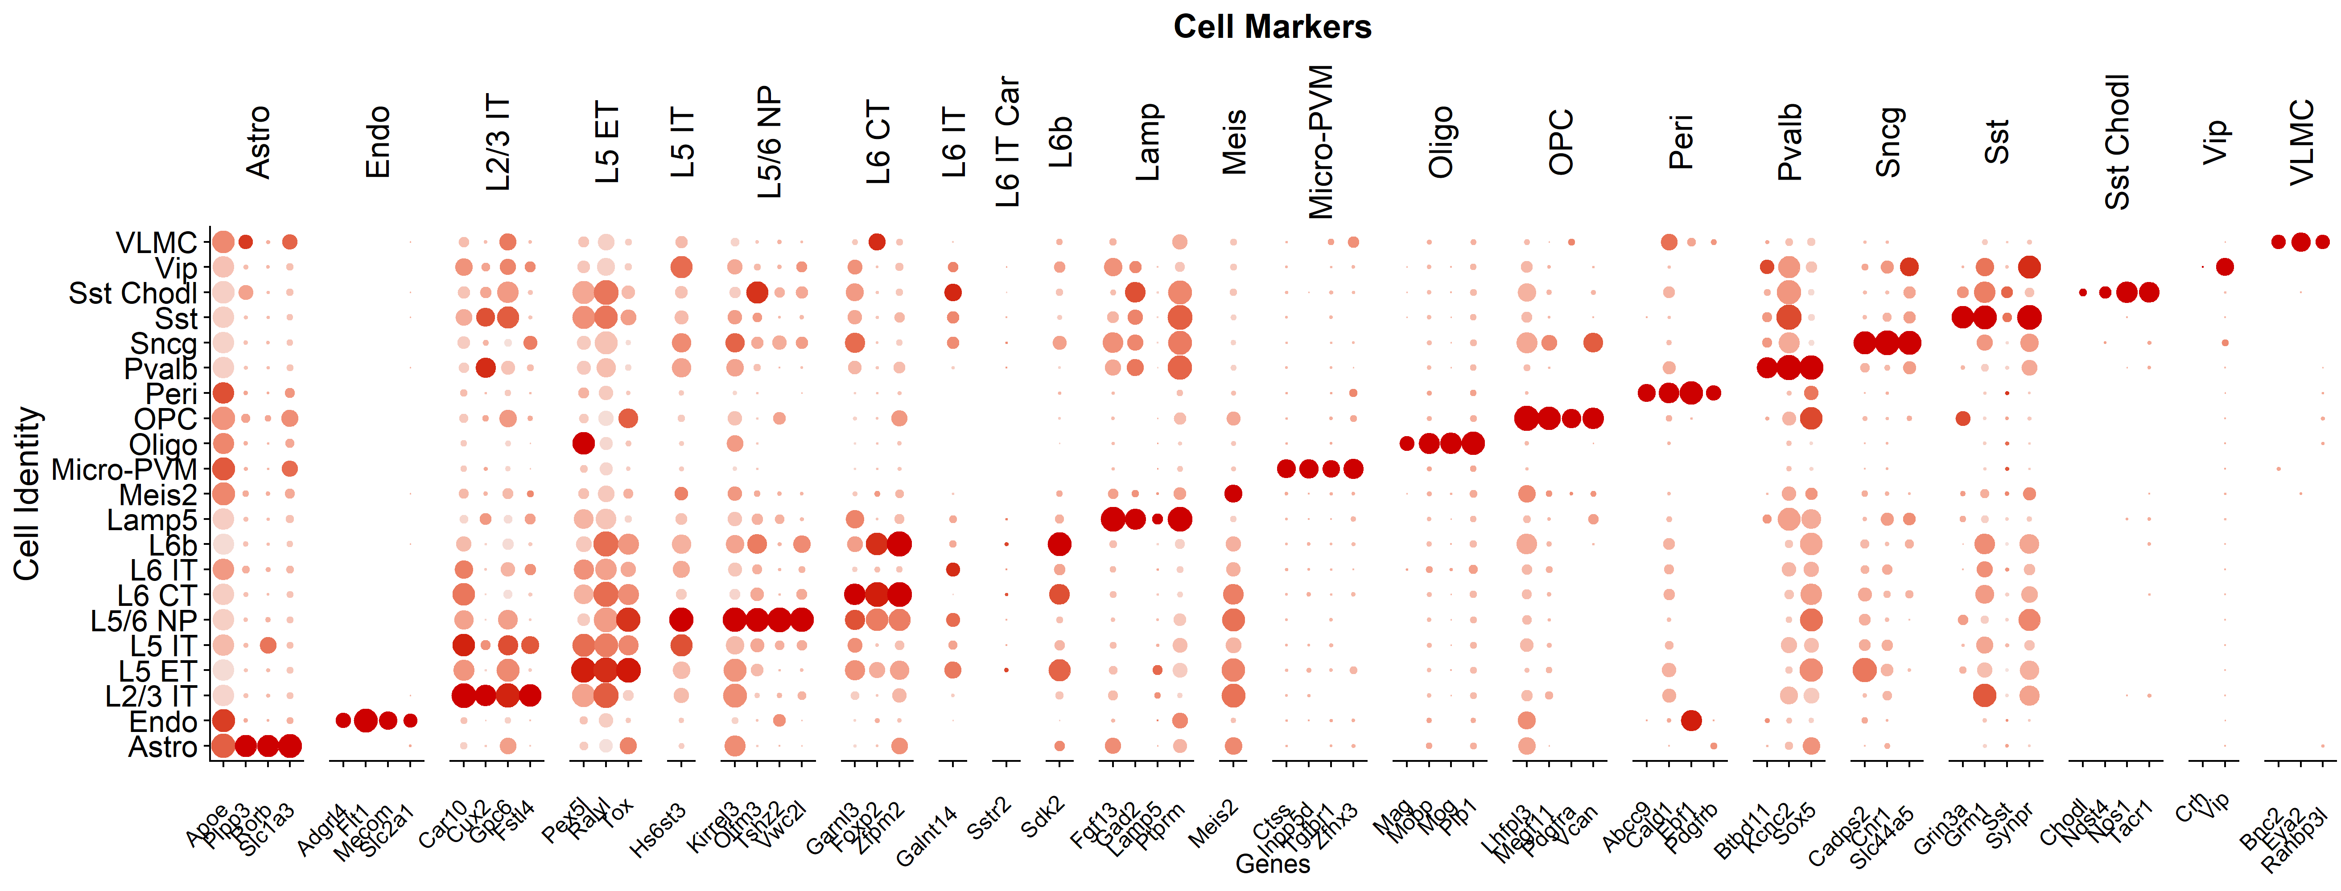
Cell Markers in dataset
67 cell-specific markers

Slide 25
Single-Cell Typical Dataset
300k cells
Each cell can be assigned to a sample (barcoding)
0 0 0 0 0 0 0 0 0 0 0 0 0 0 0 0 0 0 0 0 0 4 0 0 0 0 0 0 5 0 0 0 0 0 0 0 0 3 0 0 0 0 0 1 0 0 0 0 0
0 0 0 0 0 0 0 0 0 0 0 0 0 0 0 5 0 0 0 0 0 0 1 0 0 0 2 0 0 0 0 0 3 0 0 0 0 0 0 0 0 0 1 0 0 0 0 0 0
0 3 0 0 9 0 1 0 0 0 0 0 0 0 0 0 0 0 0 0 4 0 0 0 0 0 0 5 0 0 0 0 0 0 0 0 7 0 0 0 0 0 0 6 0 0 0 0 0
>90% are zeros
biological truth + technical limitations
Problem: common tests for differential expression are too powerful: the whole transcriptome becomes significantly changed
20k genes
Each cell can be assigned to a cell type (annotation)

Slide 26
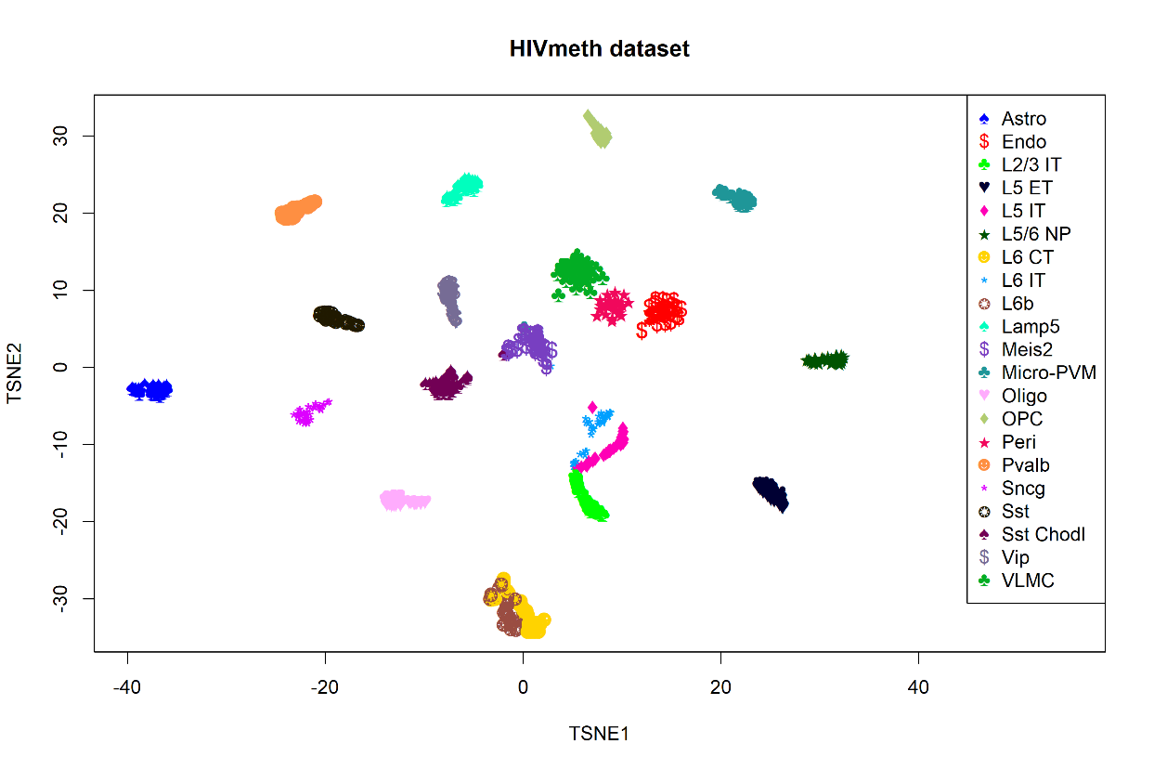
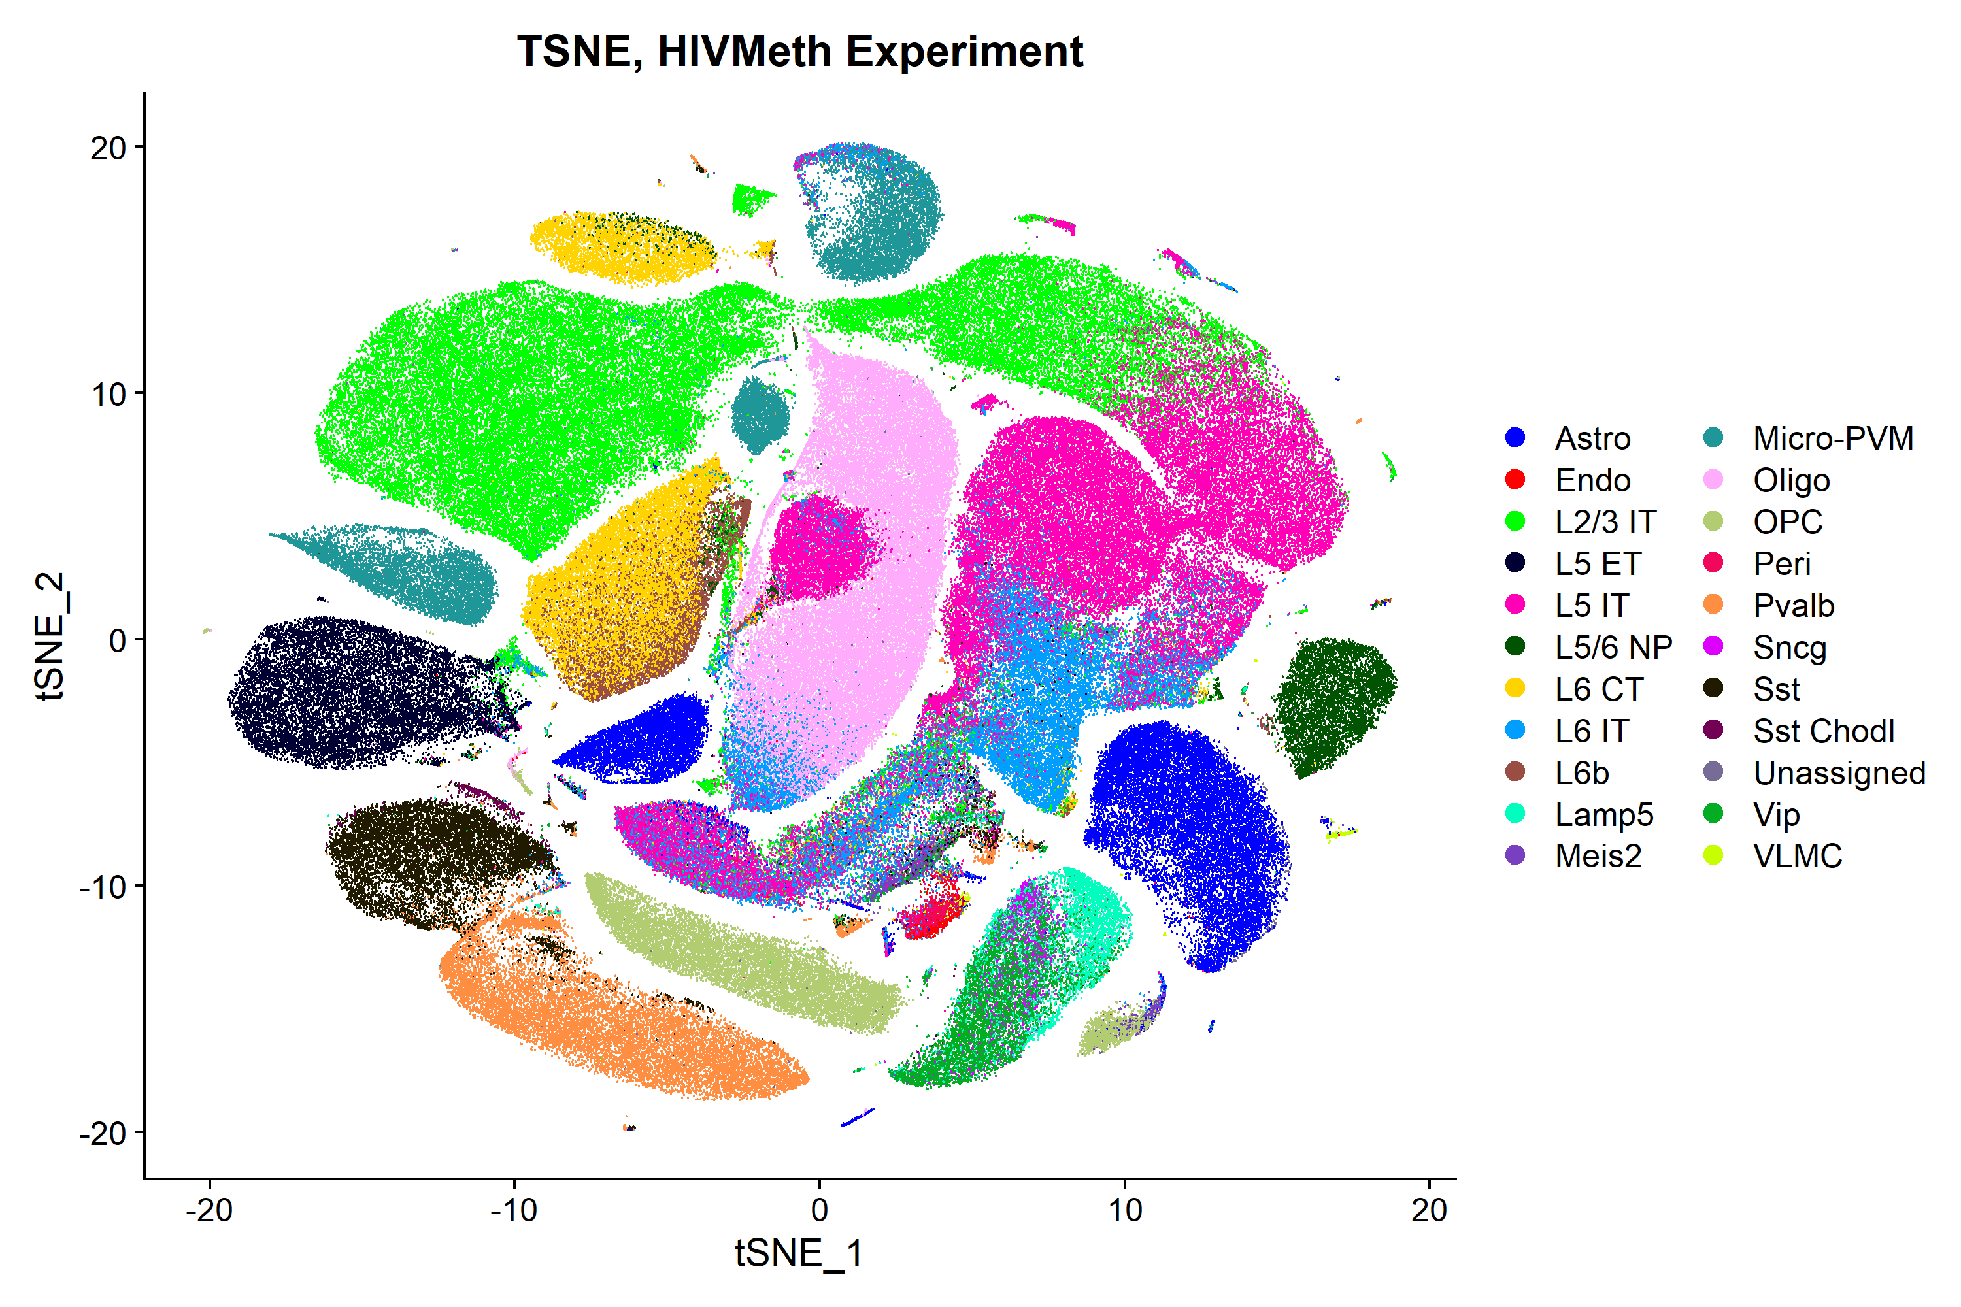
Single-Cell Typical Dataset
300k cells
Each cell can be assigned to a sample (barcoding)
0 0 0 0 0 0 0 0 0 0 0 0 0 0 0 0 0 0 0 0 0 4 0 0 0 0 0 0 5 0 0 0 0 0 0 0 0 3 0 0 0 0 0 1 0 0 0 0 0
0 0 0 0 0 0 0 0 0 0 0 0 0 0 0 5 0 0 0 0 0 0 1 0 0 0 2 0 0 0 0 0 3 0 0 0 0 0 0 0 0 0 1 0 0 0 0 0 0
0 3 0 0 9 0 1 0 0 0 0 0 0 0 0 0 0 0 0 0 4 0 0 0 0 0 0 5 0 0 0 0 0 0 0 0 7 0 0 0 0 0 0 6 0 0 0 0 0
>90% are zeros
biological truth + technical limitations
Problem: common tests for differential expression are too powerful: the whole transcriptome becomes significantly changed
20k genes
Each cell can be assigned to a cell type (annotation)
300k cells
858 pseudo samples
(39 samples x 22 cell types)

Slide 27
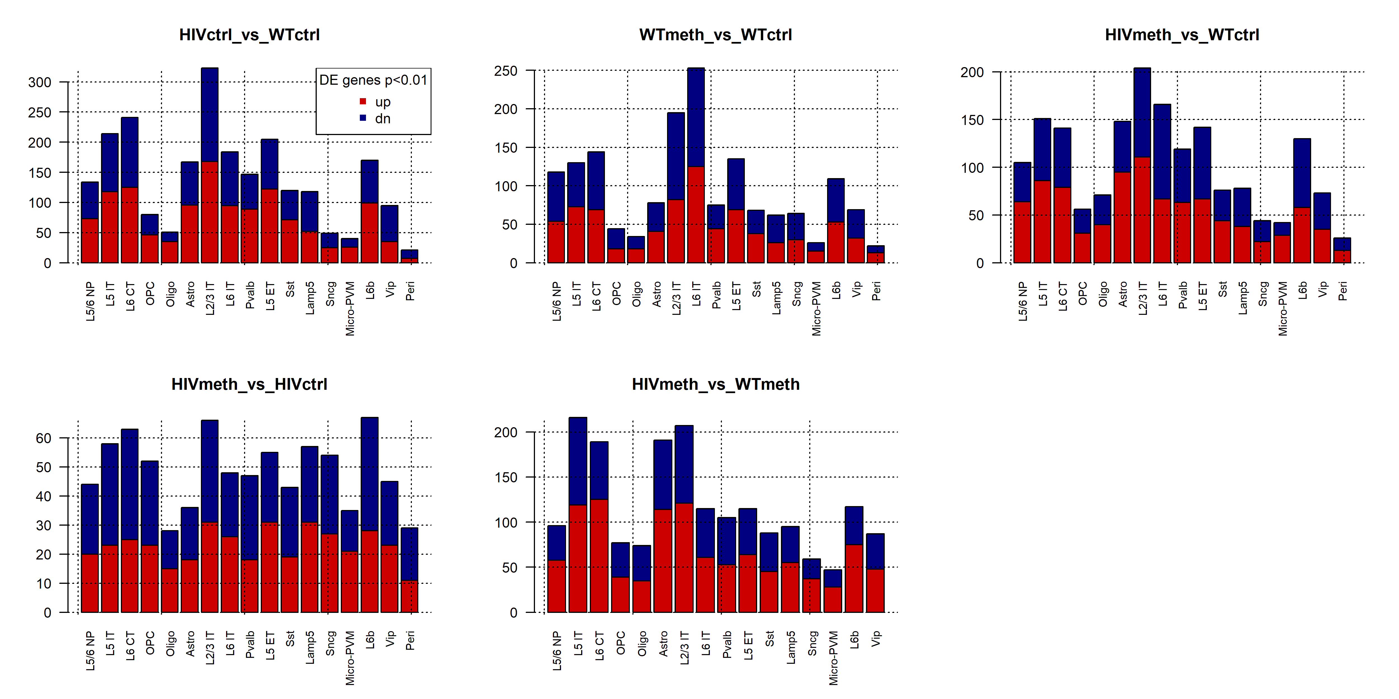
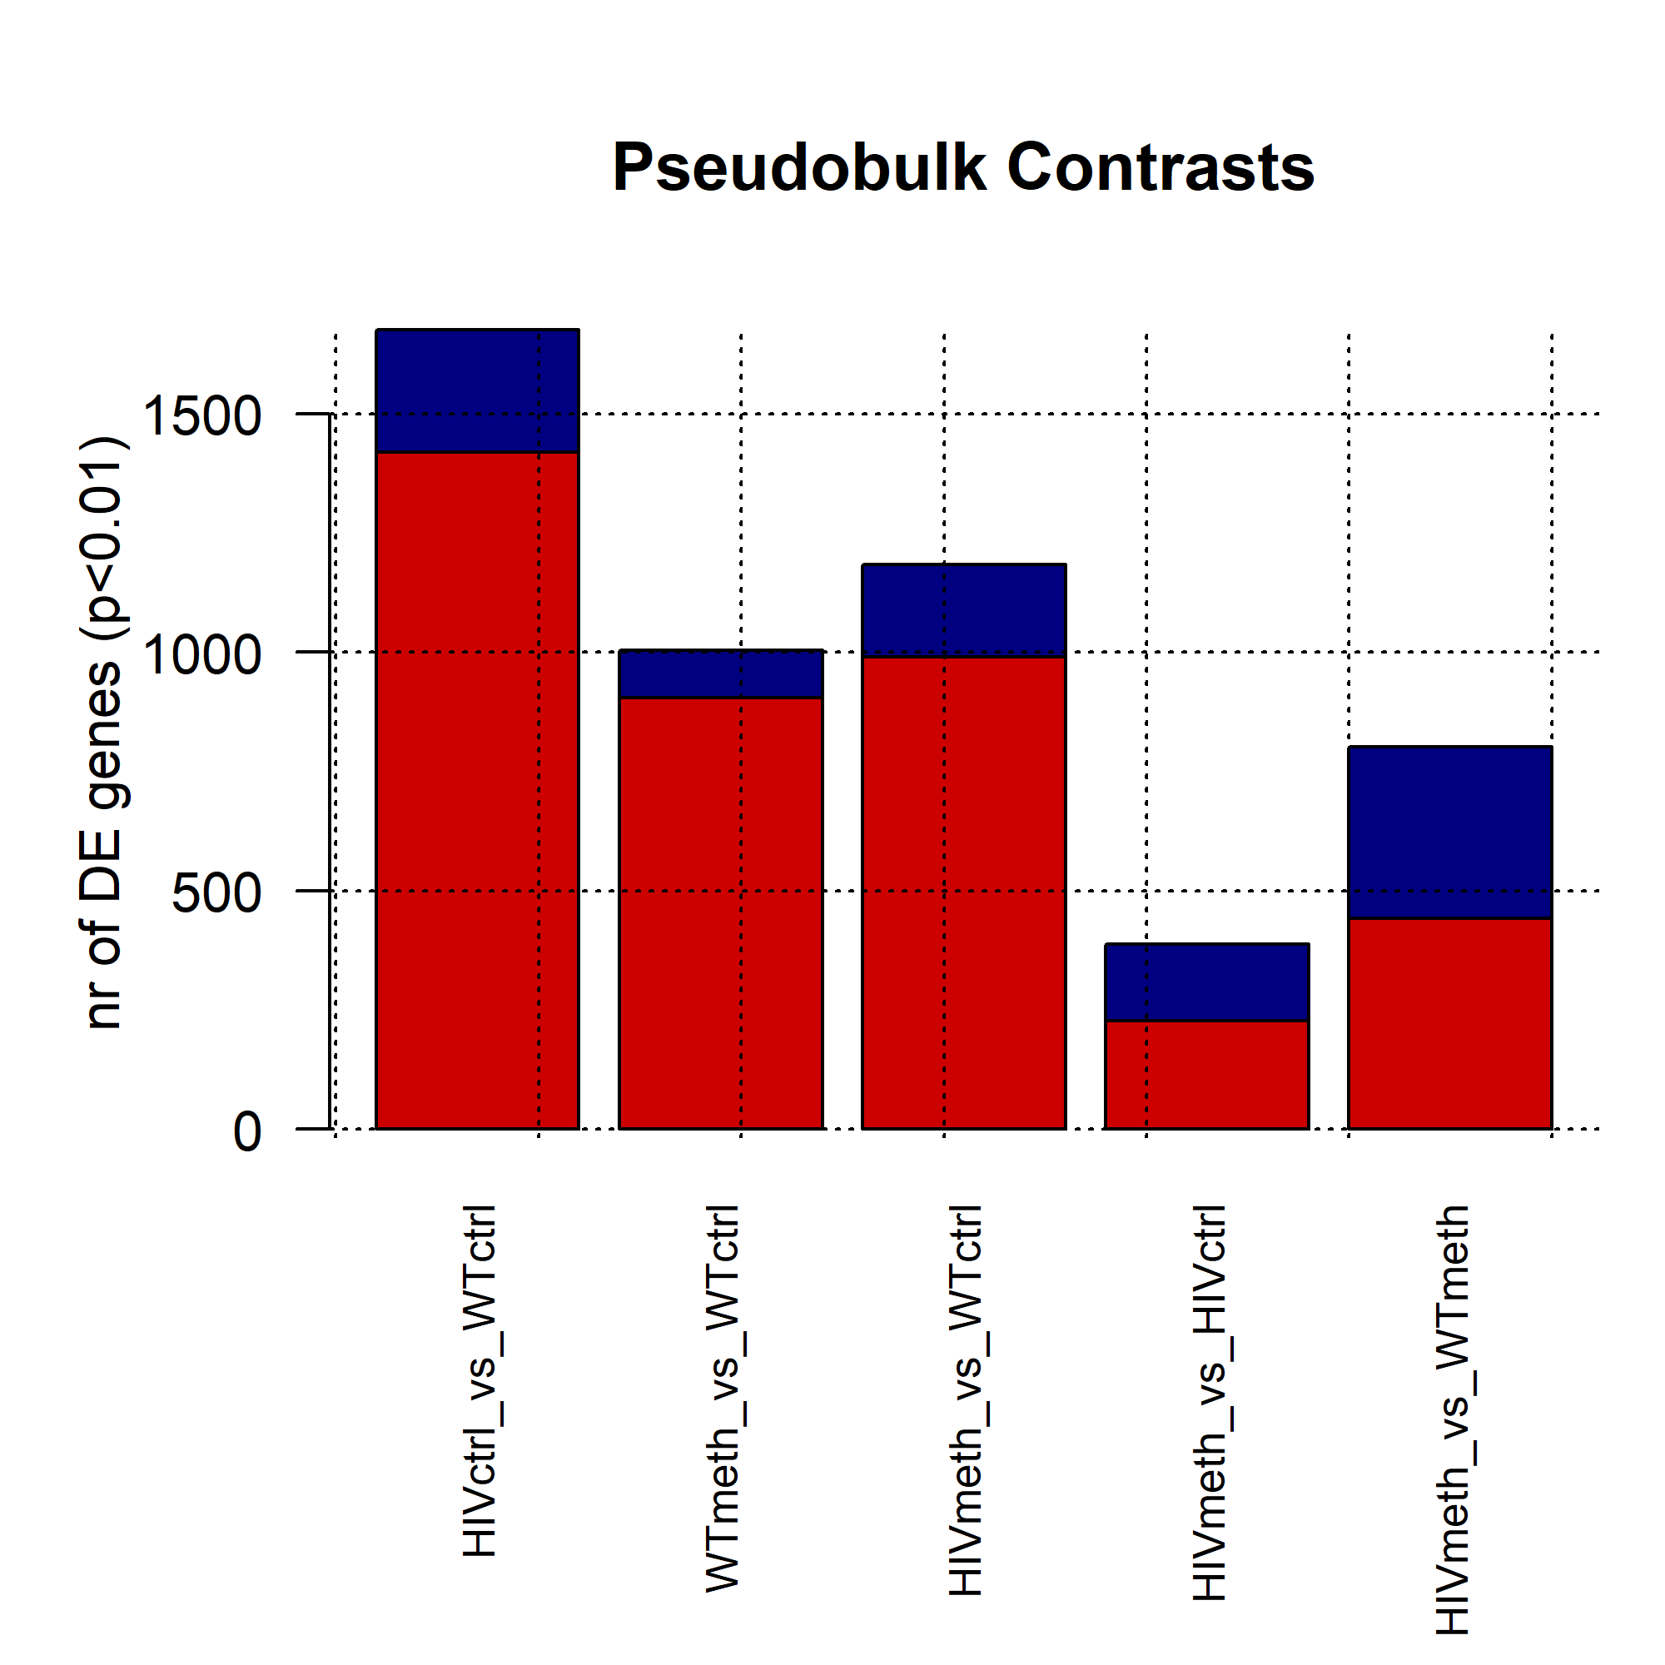
Differential Expression Overview
Number of genes

Slide 28
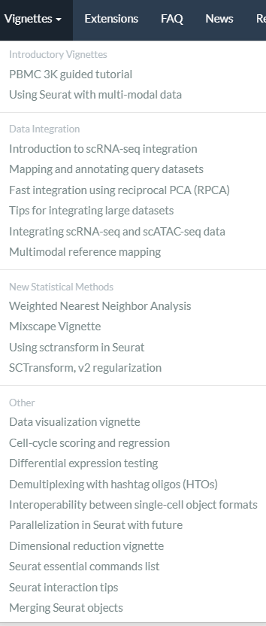


R package to operate with single-cell data
SEURAT
Not the only one, but frankly the most popular
Available on CRAN
Full of vignettes and tutorials
https://satijalab.org/seurat/

Slide 29
HANDS ON EXERCISE

Slide 30
Download the dataset
File is here:
https://www.dropbox.com/s/3uz6txc5bs4kwlb/rawcounts.txt?dl=1
2700 cells
1002 genes (usually >20,000 genes)
The original tutorial can be found here:
https://satijalab.org/seurat/articles/pbmc3k_tutorial.html
PBMC dataset
Peripheral Blood Mononuclear Cells
Lymphocytes, Monocytes, et cetera

Slide 31

Open Rstudio and let's start with loading the dataset
Set the correct directory where your file is
setwd("C:/Users/...")
Install the Seurat package (only once)
install.packages("Seurat")
Load the Seurat package
library(Seurat)

Slide 32
Open Rstudio and let's start with loading the dataset
Load the dataset (it is tab-delimited)
rawcounts<-read.delim("rawcounts.txt")
ALTERNATIVE: You can load it directly with the link, too
rawcounts<-read.delim("https://www.dropbox.com/s/3uz6txc5bs4kwlb/rawcounts.txt?dl=1")
Check the dataset size
dim(rawcounts)
1002 genes
2700 cells

Slide 33
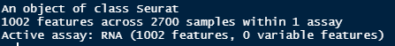
Seurat standard intro
Initialize the Seurat object with the raw (non-normalized data)
seuset<-CreateSeuratObject(counts=rawcounts)
Summary of the object
seuset

Slide 34
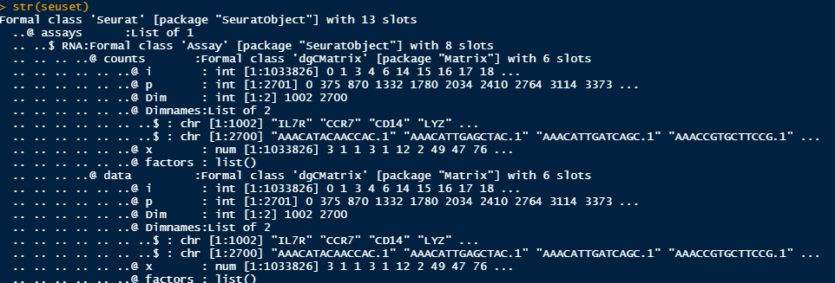
The actual content of the object... Of any R object
The legendary str() function
str(seuset)
We can extract info directly, for example the raw counts are here:
seuset@assays$RNA@counts

Slide 35

Normalize and Scale data
Most operations require normalization and scaling: clustering, coexpression, differential expression, et cetera
Seurat works by adding elements to the dataset object (here, seuset)
Normalize
seuset<-NormalizeData(seuset)
Scale
seuset<-ScaleData(seuset)
Save the scaled data
Cells (barcodes)
expmat<-seuset@assays$RNA@scale.data
expmat[1:5,1:5]
Gene Symbols

Slide 36


Dimensionality reduction
A dataset with two genes could be plotted directly on two dimensions
Each point is a cell
With thousands of genes, we would need a multidimensional space or not yet existing visualization technology

Slide 37
Dimensionality reduction
We can use some algorithms to merge the contribution of all genes and provide bidimensional projections for all samples (cells)
Popular algorithms:
PCA: Principal Component Analysis
In base R, function prcomp()
TSNE: t-distributed stochastic neighbor embedding
Implemented in the CRAN R package library(Rtsne)
UMAP: Uniform Manifold Approximation and Projection for Dimension Reduction
Implemented in the CRAN R package library(umap)
PHATE: Potential of Heat diffusion for Affinity-based Transition Embedding
Implemented in the Github R package phateR

Slide 38



Very popular techniques in Genomics

Slide 39

PCA: generating components of decreasing variance
Run the algorithm
ppp<-prcomp(t(expmat))
Extract the first two components
x<-ppp$x[,1]
y<-ppp$x[,2]
Plot
plot(x,y,main="Single Cell RNA-Seq - PCA projection",
xlab="PC1",
ylab="PC2",
pch=20)
grid(col="#00000033")

Slide 40
TSNE: projecting ALL variance on two dimensions
Install and load the package
install.packages("Rtsne")
library(Rtsne)
Run the algorithm
ttt<-Rtsne(t(expmat))
Extract coordinates (only two)
x<-ttt$Y[,1]
y<-ttt$Y[,2]

Slide 41
Exercise: plot TSNE
Plot the TSNE projection of the dataset stored in expmat

Slide 42

Solution
plot(x,y,main="Single Cell RNA-Seq - TSNE projection",
xlab="TSNE1",
ylab="TSNE2",
pch=20)
grid(col="#00000033")

Slide 43
PCA vs. TSNE
TSNE (like UMAP or PHATE) is immensely more popular than PCA
You don't have to select the specific components. All dataset is already projected in two dimensions
Drawbacks
TSNE is a bit slower than PCA
TSNE is non-deterministic (it can provide slightly different results every time)

Slide 44
OK but what are these cells?
Each dot is a cell with expression levels for all genes
How can we group this dataset in distinct clusters?
How can we associate a cluster to a known cell type?

Slide 45
Unsupervised clustering
"Unsupervised" because we do not provide prior knowledge (e.g. that there are Lymphocites expressing the CD8A gene)
Many ways to do this. Today we will follow blindly the Seurat way:
Simple and Fast
Based on PCA projection
Uses a clustering algorithm called Louvain
The process assigns every cell to a cluster
Seurat Unsupervised clustering
seuset<-FindVariableFeatures(seuset)
seuset<-RunPCA(seuset,features=VariableFeatures(object=seuset))
seuset<-FindNeighbors(seuset,dims=1:10)
seuset<-FindClusters(seuset,resolution=0.5)

Slide 46

Prepare for plotting the clusters (1)
The meta.data contains the cluster assignment for each cell
seuset@meta.data

Slide 47
Prepare for plotting the clusters (2)
Define n, the number of clusters
n<-length(unique(seuset@meta.data$seurat_clusters))
n = 8 (clusters 0 1 2 3 4 5 6 7)
Define a color for each cluster
colors<-setNames(DiscretePalette(n,palette="glasbey"),as.character(0:(n-1)))
colors
Match colors to each cluster with this trick
matched_colors<-colors[seuset@meta.data$seurat_clusters]

Slide 48

Plot TSNE with clustering information
x<-ttt$Y[,1]
y<-ttt$Y[,2]
plot(x,y,main="Single Cell RNA-Seq - TSNE projection",
xlab="TSNE1",ylab="TSNE2",pch=20,
col=matched_colors)
grid(col="#00000033")
legend("bottomright",legend=names(colors),col=colors,pch=20,title="Cluster")

Slide 49
Plot TSNE with clustering information

Slide 50
Cluster - to - cell type assignment
Each cluster is not just a cloud of colored cells
Each cluster can be defined by a list of markers, i.e. genes expressed specifically in that cluster (compared to the other clusters)
The process assigns every cell to a cluster
Find All Markers
markers<-FindAllMarkers(seuset,min.pct=0.25,logfc.threshold=0.25,only.pos=TRUE)
Find genes for each cluster, present in at least 25% of the cluster cells, with at least positive 0.25 log(Fold Change)

Slide 51


Markers
markers

Slide 52
We can extract the top 10 markers for each cluster
# Top 10 markers for each cluster (0 to 6)
markers$gene[markers$cluster==0][1:10]
markers$gene[markers$cluster==1][1:10]
markers$gene[markers$cluster==2][1:10]
markers$gene[markers$cluster==3][1:10]
markers$gene[markers$cluster==4][1:10]
markers$gene[markers$cluster==5][1:10]
markers$gene[markers$cluster==6][1:10]
markers$gene[markers$cluster==7][1:10]

Slide 53
(HARD) Exercise
Rename all clusters to the most likely cell type based on the following table
Replot the TSNE with clusters named after the cell type
Markers | Cell Type
IL7R | Memory CD4+ T Lymphocytes
CD14, LYZ | CD14+ Monocytes
CCR7 | Naive CD4+ T Lymphocytes
CD8A | CD8+ T Lymphocytes
MS4A1 | B Lymphocytes
FCGR3A, MS4A7 | FCGR3A+ Monocytes
GNLY, NKG7 | Natural Killers

Slide 54


Slide 55
Solution
# Create a new color object
newcolors<-colors
names(newcolors)[names(newcolors)=="0"]<-"Naive T Lymphocytes"
names(newcolors)[names(newcolors)=="1"]<-"Memory T Lymphocytes"
names(newcolors)[names(newcolors)=="2"]<-"CD14+ Monocytes"
names(newcolors)[names(newcolors)=="3"]<-"CD8+ T Lymphocytes"
names(newcolors)[names(newcolors)=="4"]<-"B Lymphocytes"
names(newcolors)[names(newcolors)=="5"]<-"FCGR3A+ Monocytes"
names(newcolors)[names(newcolors)=="6"]<-"Natural Killers"
names(newcolors)[names(newcolors)=="7"]<-"Unknown"
# Replot
plot(x,y,main="Single Cell RNA-Seq - TSNE projection",
xlab="TSNE1",
ylab="TSNE2",
pch=20,
col=matched_colors)
grid(col="#00000033")
legend("bottomright",legend=names(newcolors),col=newcolors,pch=20,title="Cluster")

Slide 56


Slide 57
Federico Manuel Giorgi
Department of Pharmacy and Biotechnology
University of Bologna
Email: federico.giorgi@unibo.it
Twitter: @giorgilab

Slide 58


